Slide 1
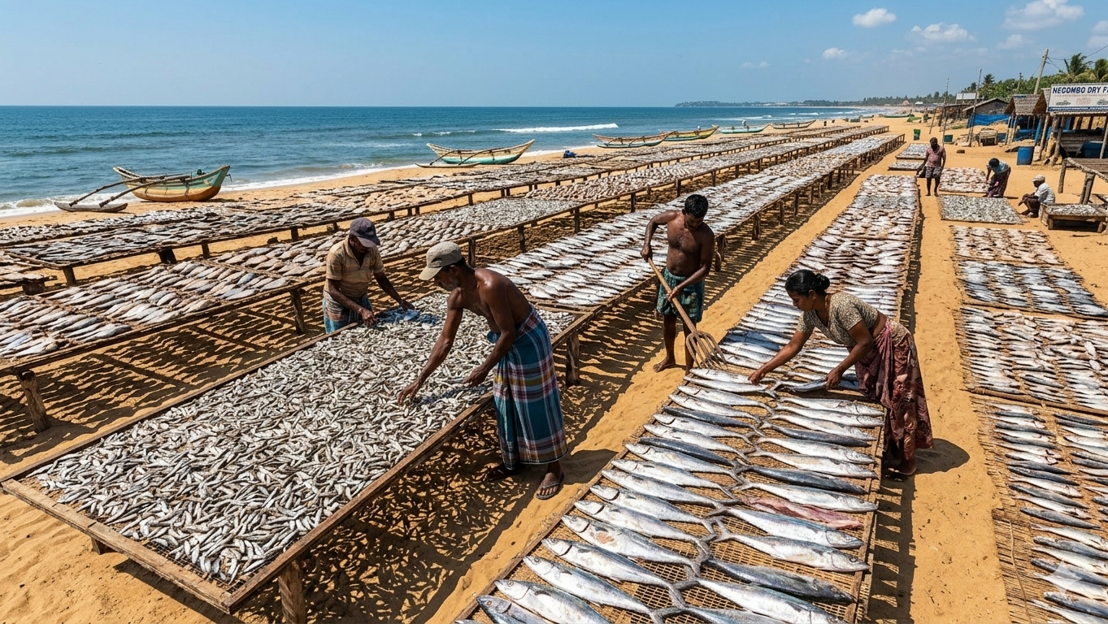

A Smart IoT-Driven Digital Platform for Sustainable Dry Fish Processing in Sri Lanka
Project ID : RP-026-079

Slide 2


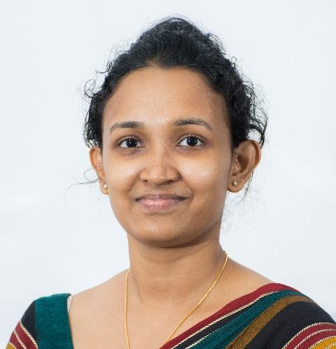
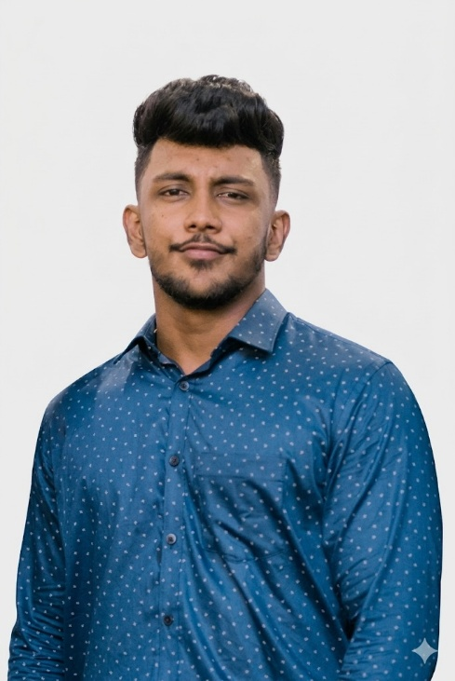
Supervisor
Ms. Jenny Krishara
Co-Supervisor
Dr. Dinuka Wijendra
External Supervisor
Mr. Dinuth Jayasekara

Slide 3
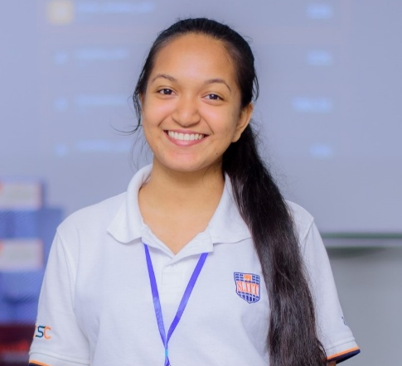
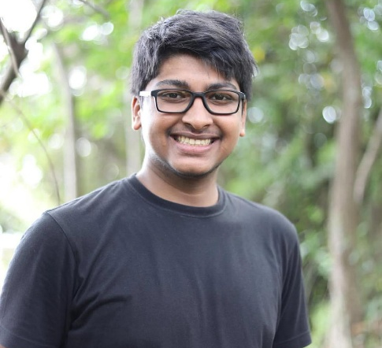
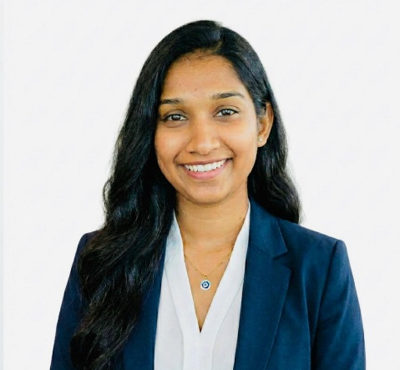
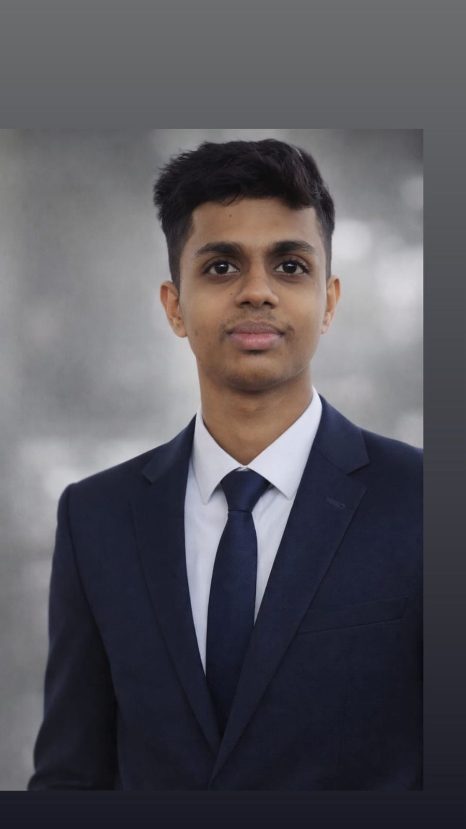
Team Leader
VIVIPEM L B R V IT22639844
GUNASEKARA D T C D P IT22127396
PESHALA G A K J IT22554536
SANJAYA E W M IT22189394

Slide 4
Content
Introduction Video
Introduction
Research Problem
Objectives
System Overview Diagram
Technologies
Individual Component
Commercialization Aspects
Gantt Chart
Work Breakdown Structure (WBS)
<< RP-026-079>>

Slide 5
01. Introduction Video
<< RP-026-079>>

Slide 6

<< RP-026-079>>

Slide 7
02. Introduction
About Dry Fish Processing?
Importance of the Industry
Supports many coastal fishing communities.
Provides an affordable protein source.
Reduces fish spoilage and waste.
Traditional fish preservation method in Sri Lanka.
Fish is cleaned, salted, and sun-dried to extend shelf life.
What will the System Improve?
Monitor drying conditions using IoT sensors.
Predict drying time and spoilage risk.
Maintain digital records of processing batches.
<< RP-026-079>>

Slide 8
03. Research Problem
Current Challenges
Drying decisions depend on experience.
Weather conditions affect drying quality.
Lack of monitoring and traceability systems.
Impact
Post-harvest losses and inconsistent product quality.
Limited traceability of processing batches.
<< RP-026-079>>

Slide 9
04. Research Question
The platform will focus on
Monitoring drying conditions using IoT sensors
How can an IoT-driven digital platform using machine learning and computer vision improve monitoring, prediction and traceability in dry fish processing in Sri Lanka?
Predicting drying completion time and spoilage risk
Detecting quality defects using computer vision
Maintaining digital traceability of processing batches
<< RP-026-079>>

Slide 10
05. Objectives
Main Objective
Develop a smart IoT-driven digital platform to improve efficiency, quality control, and sustainability in dry fish processing.
Specific Objectives
Collect drying data using IoT sensors.
Develop machine learning models to predict drying time and spoilage risk.
Detect quality issues using computer vision techniques.
Maintain digital traceability records for processing batches.

Slide 11
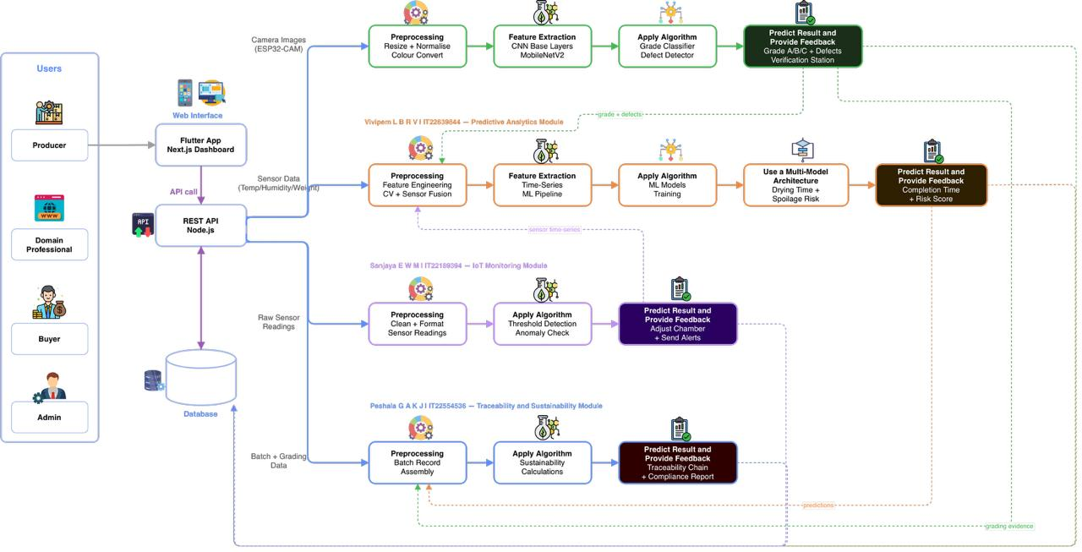
06. System Overview Diagram

Slide 12




07. Technologies
Programming Language – Flutter, Node.js
Machine Learning Framework – Python
Database – MongoDB

Slide 13

VIVIPEM L B R V | IT22639844
BSc (Hons) Degree in Information Technology (Specialization in Information Technology)
IT22639844 | VIVIPEM L B R V | RP-026-079

Slide 14
Component 01: ML-based Predictive Analytics Module For Dry Fish Processing
Traditional dry fish processing is manual and weather-dependent; processors determine drying completion using visual inspection and personal experience. [1][2].
Result: ~20–30% post-harvest loss from over-drying, under-drying, or spoilage (e.g. humidity spikes) [1][2].
Existing IoT systems show live sensor data but do not predict drying time or spoilage risk [3][4].
Problem Definition
IT22639844 | VIVIPEM L B R V | RP-026-079

Slide 15


Objectives
Sub Objectives
Collect and store sensor data (temperature, humidity, weight).
Extract time-series features(rolling averages, humidity trends, weight loss) [5], [6].
Main Objective​
Develop an ML-based predictive analytics module to estimate drying completion time and predict spoilage risk in dry fish processing using IoT sensor data.
Develop a regression model to predict drying completion time.
Develop classification models to predict spoilage risk levels.
Evaluate models using standard performance metrics(MAE, RMSE, Accuracy, Precision, Recall, and F1-score.).
Deploy the trained models as a FastAPI prediction service and integrate with a mobile dashboard for real-time alerts
IT22639844 | VIVIPEM L B R V | RP-026-079

Slide 16
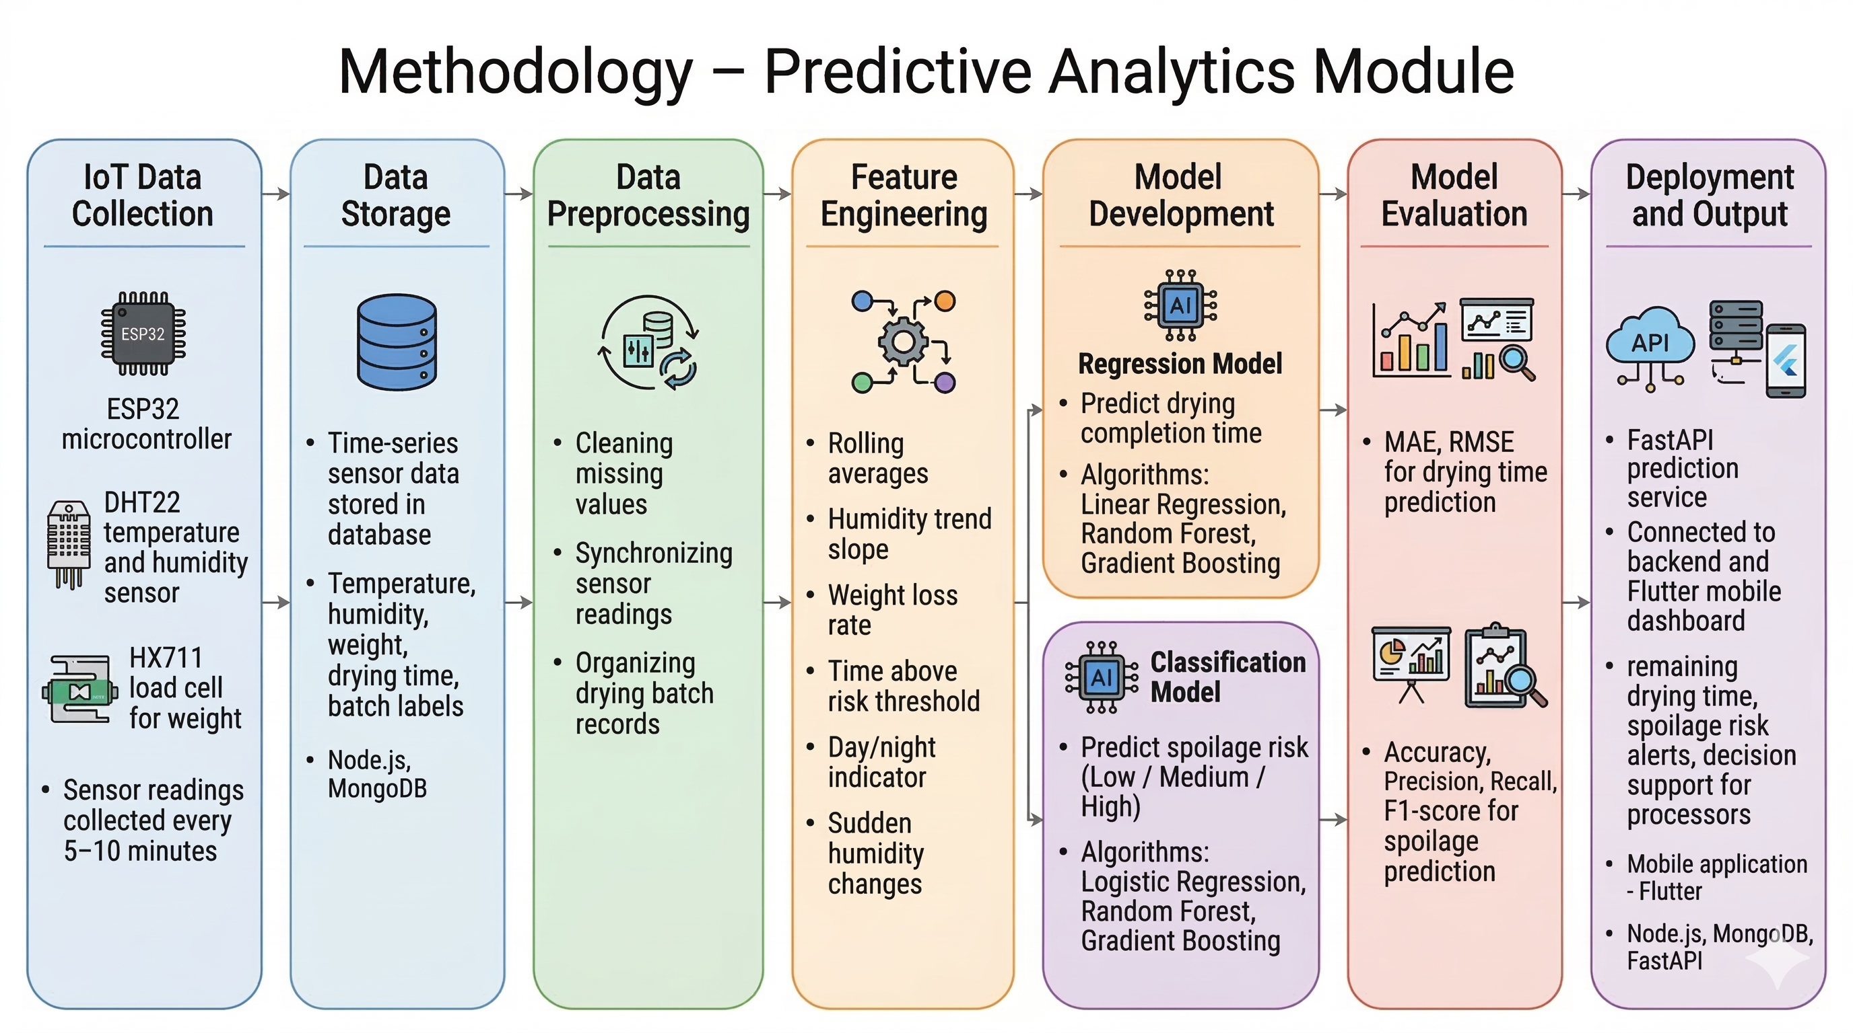
Methodology
IT22639844 | VIVIPEM L B R V | RP-026-079

Slide 17
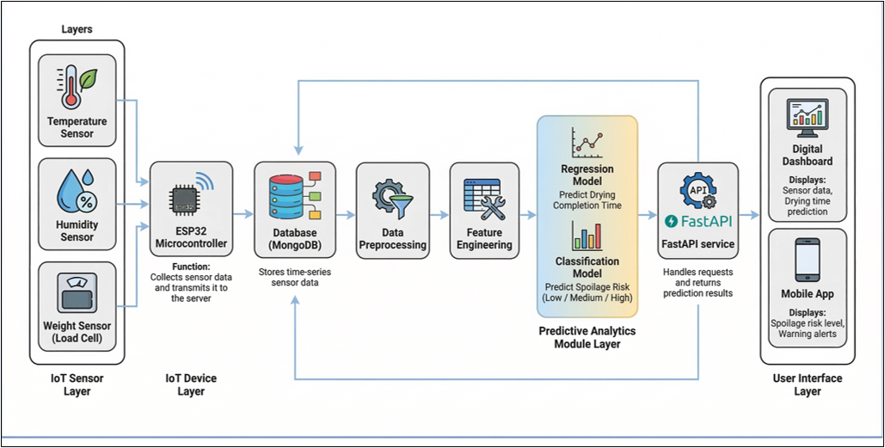
Component Diagram
IT22639844 | VIVIPEM L B R V | RP-026-079

Slide 18
Evidence of completion
• IoT sensor data collection and dataset creation
• Feature engineering for sensor time-series data
• Machine learning models for drying time and spoilage prediction
• Model evaluation and performance comparison
• FastAPI prediction service and mobile dashboard integration

Slide 19
References
[1] National Aquatic Resources Research and Development Agency (NARA), "Post-Harvest Losses in the Sri Lankan Dry Fish Industry: Status and Recommendations," NARA Technical Report, Colombo, Sri Lanka, 2022.
[2] R. P. Jayasinghe, S. S. K. Haputhanthri, and A. D. Ranasinghe, "Assessment of post-harvest losses in traditional dry fish processing in Southern Sri Lanka," Sri Lanka J. Aquatic Sciences, vol. 26, no. 1, pp. 45–58, 2021.
[3] A. Fudholi, K. Sopian, M. H. Ruslan, and M. Y. Othman, "IoT-based monitoring system for solar drying of agricultural products," J. Advanced Research in Fluid Mechanics and Thermal Sciences, vol. 56, no. 1, pp. 1–12, 2019.
[4] K. Srinivasan and R. Kumar, "Smart fish drying system using IoT sensors and threshold-based alerts," in Proc. IEEE Int. Conf. on IoT and Its Applications (ICIOT), Bangalore, India, 2020, pp. 112–117.
[5] P. S. Taoukis and T. P. Labuza, "Time-Temperature Indicators (TTIs)," in Novel Food Processing Technologies, G. V. Barbosa-Canovas et al., Eds. Boca Raton, FL: CRC Press, 2005, ch. 5, pp. 103–126.
[6] V. Singh, A. K. Gupta, and S. P. Singh, "Weight loss kinetics during fish drying: Mathematical modeling and experimental validation," J. Food Engineering, vol. 246, pp. 112–120, 2019.

Slide 20
GUNASEKARA D T C D P | IT22127396
BSc (Hons) Degree in Information Technology (specialization in Information Technology)
IT22127396 | GUNASEKARA D T C D P | RP-026-079

Slide 21
Component 02: AI-POWERED COMPUTER VISION QUALITY GRADING AND CONTAMINATION DETECTION FOR DRY FISH PROCESSING
Dry fish quality grading relies entirely on manual visual inspection with no consistent standard applied.
Processors cannot detect contamination such as mould, insect eggs and bacterial growth until visible damage has already occurred.
No automated or objective grading system exists for Sri Lankan dry fish species and processing conditions.
Grading outcomes vary between individuals depending on experience, fatigue and personal judgment, producing inconsistent results.
There is no locally trained image dataset or AI model built specifically for Sri Lankan dry fish quality assessment.
Problem Definition
IT22127396 | GUNASEKARA D T C D P | RP-026-079
Notes:
"Good morning.
One simple question — how do we know if dry fish is good quality in Sri Lanka?
One person looks at it. And decides. No standard. No tool. No record.
Nobody knows if the fish is fully dried or still wet inside. They guess. And that guess costs them money when the batch is rejected at market.
Contamination like mould and insect eggs — by the time a human eye sees it, the damage is already done.
Not a single AI model exists trained specifically for Sri Lankan dry fish.
That is what my component solves."

Slide 22
Objectives
Sub Objectives
Collect and label a Sri Lankan dry fish image dataset covering Grade A, B, C and defects.
Train a CNN model using transfer learning achieving minimum F1-score of 0.75.
Specific Objective
To design and develop an AI-powered computer vision module that automatically grades dry fish quality and detects contamination using a self-learning CNN model within a controlled drying environment.
Implement dual-mode camera for live streaming and periodic auto-capture under standardised lighting.
Develop a Verification Station for professionals to review and correct low-confidence predictions.
Establish a self-learning retraining pipeline to improve model accuracy over time.
Integrate grading results with predictive analytics and batch traceability record.
IT22127396 | GUNASEKARA D T C D P | RP-026-079
Notes:
"My objective — build an AI computer vision module that automatically grades dry fish, tracks drying status, and detects contamination using a self-learning CNN model inside our controlled chamber.
Six sub objectives: Build the dataset. Train the model. Implement dual camera. Build the Verification Station. Create the self-learning loop. Connect to the platform."

Slide 23
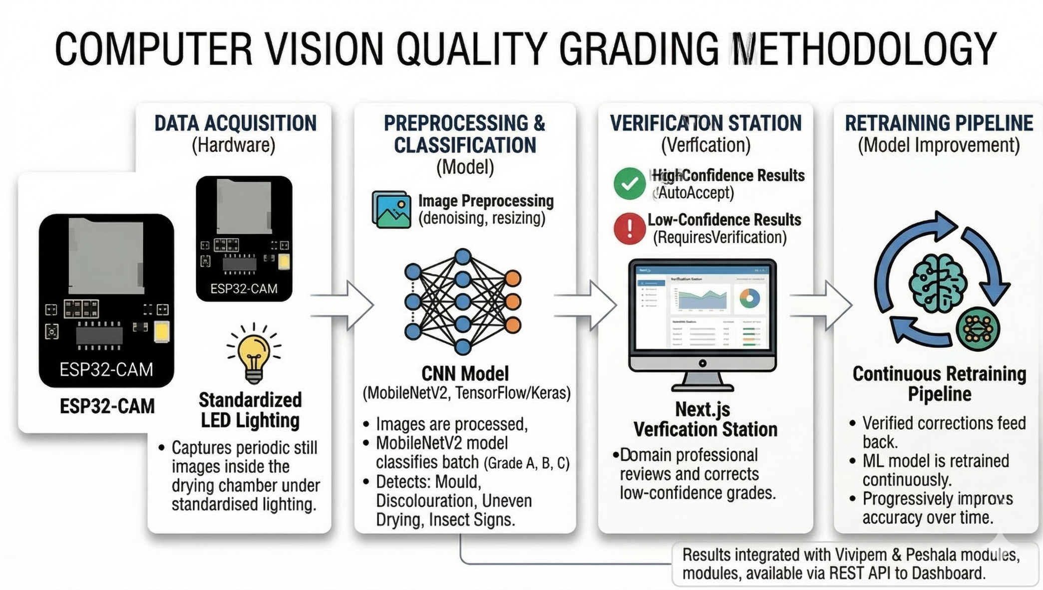
Methodology
M
IT22127396 | GUNASEKARA D T C D P | RP-026-079
Notes:
"Four steps.
Step one — Data Acquisition. ESP32-CAM captures images automatically at regular intervals throughout the full drying cycle under standardised LED lighting inside the chamber. Controlled lighting eliminates the number one reason food AI systems fail in real conditions.*
Step two — Preprocessing and Classification. Every image goes through OpenCV first — the preparation kitchen before the chef. It resizes, normalises, and converts colour space so every image entering the model is perfectly consistent.* Then it enters our CNN — MobileNetV2, TensorFlow and Keras.* The model does three things simultaneously.* One — drying status. By analysing surface colour, texture and moisture appearance across captures, it tells us — wet, partially dried, or fully dried — live, at every interval.* Two — quality grade. Grade A, B, or C.* Three — defect detection. Mould, discolouration, uneven drying, insect signs.* All under 10 seconds.*
Step three — Verification Station. High confidence — auto accepted.* Low confidence — goes to our Next.js Verification Station. Domain professional reviews, corrects, submits.*
Step four — Retraining Pipeline. Every correction retrains the model. It improves every cycle. Referral rate drops — that is our measurable proof."*

Slide 24
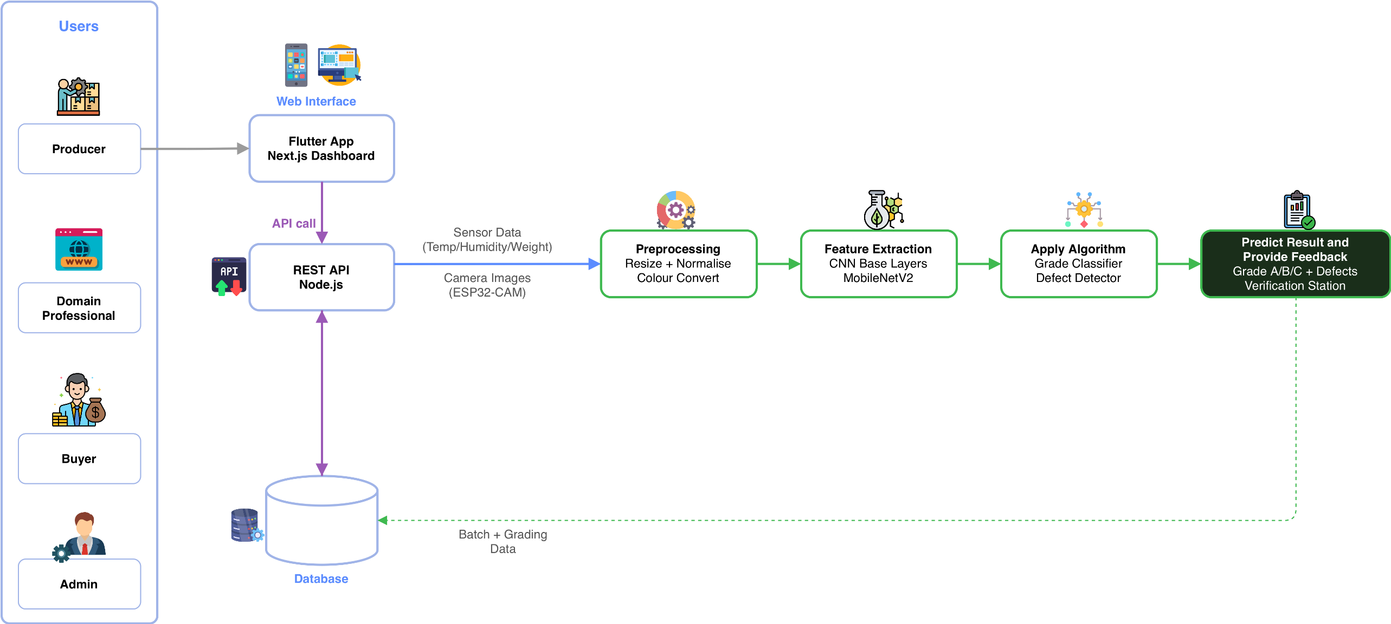
individual Component Diagram
IT22127396 | GUNASEKARA D T C D P | RP-026-079
Notes:
"Two inputs — camera images and sensor data — through the REST API.
Four stages — OpenCV preprocessing, Feature Extraction, Algorithm, Output.
Three outputs — drying status, quality grade, defect flags.
High confidence to dashboard. Low confidence to Verification Station.
Drying status feeds Vivipem's prediction engine for more accurate completion time. Grade and defects store permanently in Peshala's traceability record.
My module feeds the entire platform."

Slide 25
Evidence of completion
Labelled dry fish image dataset covering Grade A, B, C and defect categories
OpenCV preprocessing pipeline with resize, normalise and colour conversion
Trained CNN model (MobileNetV2 / TensorFlow / Keras) with evaluation results and confusion matrix
Drying status detection across periodic image captures (wet / partial / fully dried)
Next.js Verification Station dashboard with professional correction and audit log
Self-learning retraining pipeline with measurable referral rate decline across cycles
FastAPI inference service + Flutter mobile dashboard integration
IT22127396 | GUNASEKARA D T C D P | RP-026-079
Notes:
"Finally — what I will deliver as evidence.
First — a fully labelled dry fish image dataset covering Grade A, B, C, drying status stages, and all defect categories.
Second — OpenCV preprocessing pipeline — tested and documented.
Third — trained CNN model with evaluation results, F1-score, accuracy, and confusion matrix.
Fourth — drying status detection working across periodic captures — wet, partial, fully dried.
Fifth — Next.js Verification Station live with professional correction and full audit log.
Sixth — self-learning retraining pipeline with measurable referral rate decline across cycles.
And seventh — FastAPI inference service fully integrated with the Flutter mobile dashboard.
Every deliverable is documented, tested, and connected to the platform."

Slide 26
References
[1] A. Krizhevsky, I. Sutskever, and G. E. Hinton, "ImageNet classification with deep convolutional neural networks," Communications of the ACM, vol. 60, no. 6, pp. 84–90, 2017.
[2] S. J. Pan and Q. Yang, "A survey on transfer learning," IEEE Transactions on Knowledge and Data Engineering, vol. 22, no. 10, pp. 1345–1359, Oct. 2010.
[3] Google Developers, "MobileNetV2: The next generation of on-device computer vision networks," Google AI Blog, 2018. [Online]. Available: https://ai.googleblog.com/2018/04/mobilenetv2-next-generation-of-on.html [Accessed: Mar. 16, 2026].
[4] OpenCV Team, "OpenCV — Open Source Computer Vision Library," OpenCV Documentation, 2024. [Online]. Available: https://opencv.org [Accessed: Mar. 16, 2026].
[5] TensorFlow Team, "Transfer learning and fine-tuning," TensorFlow Documentation, 2024. [Online]. Available: https://www.tensorflow.org/tutorials/images/transfer_learning [Accessed: Mar. 16, 2026].
IT22127396 | GUNASEKARA D T C D P | RP-026-079
Notes:
"I am building the eyes of this platform — an AI that watches Sri Lankan dry fish, tracks when it is ready, grades its quality, and detects contamination — automatically, objectively, and smarter every day.
Thank you."

Slide 27
PESHALA G A K J | IT22554536
BSc (Hons) Degree in Information Technology (specialization in Information Technology)
IT22554536 | PESHALA G A K J | RP-026-079

Slide 28
Component 03: AI-Based Waste, Salt Prediction, and Batch Traceability System for Sustainable Dry Fish Processing
Dry fish processing generates significant waste during the fish cleaning stage.
Processors usually do not know the expected waste amount before cleaning.
Waste is often improperly disposed of, causing environmental pollution and resource loss.
Salt quantities are typically determined by experience rather than data, leading to inconsistent product quality.
There is no digital traceability system to track processing batches and waste generation.
Problem
Definition
IT22554536 | PESHALA G A K J | RP-026-079

Slide 29
Objectives
Sub Objectives
Develop a digital batch recording system for processing traceability.
Specific Objective
Build a machine learning model to predict fish cleaning waste.
To design and evaluate an AI-based waste prediction and traceability system that estimates fish cleaning waste and recommends appropriate salt quantities while maintaining digital batch records.
Implement a notification system for recycling companies based on predicted waste.
Develop a salt requirement prediction model.
Integrate predictions and records into a mobile monitoring platform.
Evaluate system performance using MAE and usability feedback.
IT22554536 | PESHALA G A K J | RP-026-079

Slide 30
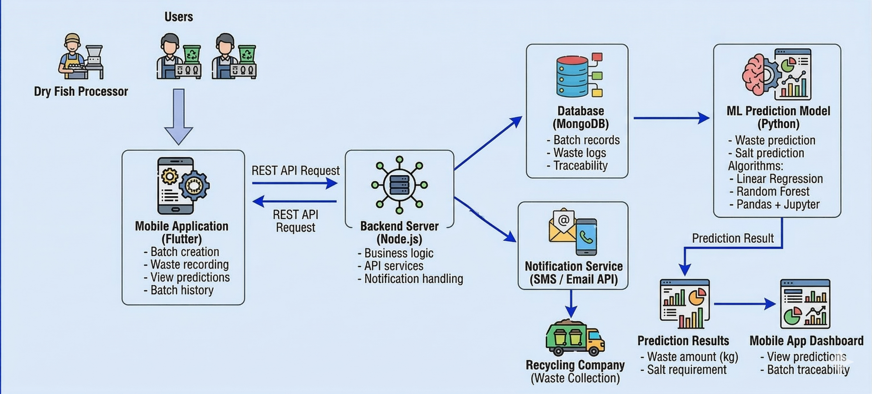
Methodology
IT22554536 | PESHALA G A K J | RP-026-079

Slide 31
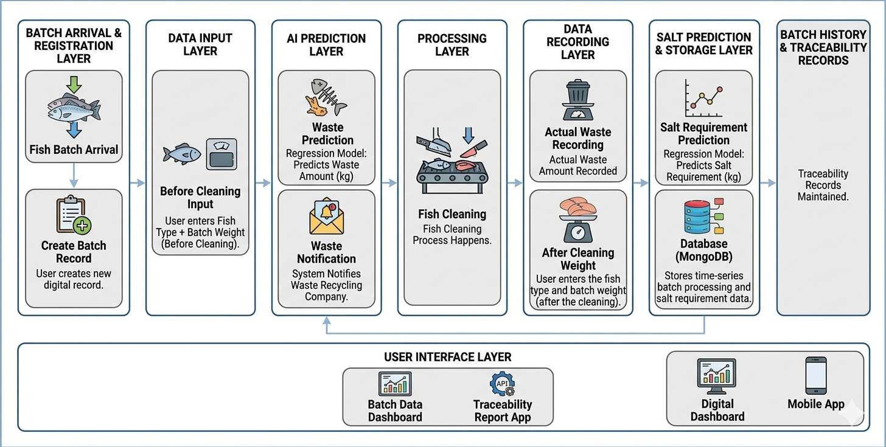
individual Component Diagram
IT22554536 | PESHALA G A K J | RP-026-079

Slide 32
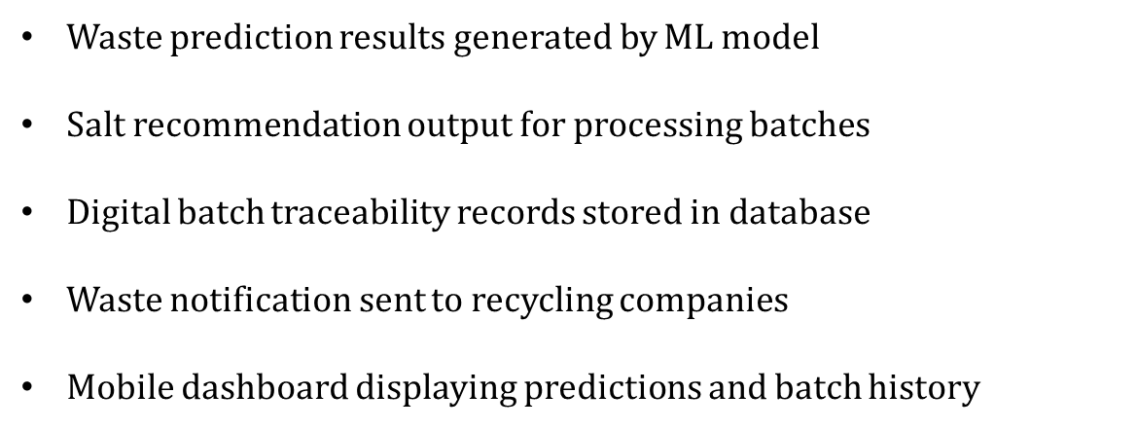
Evidence of completion
IT22554536 | PESHALA G A K J | RP-026-079

Slide 33
References
[1] A. E. Ghaly, V. V. Ramakrishnan, M. S. Brooks, S. M. Budge, and D. Dave, “Fish processing wastes as a potential source of proteins, amino acids and oils: A critical review,” Journal of Microbial & Biochemical Technology, vol. 5, no. 4, pp. 107–129, 2013.
[2] I. S. Arvanitoyannis and A. Kassaveti, “Fish industry waste: Treatments, environmental impacts, current and potential uses,” International Journal of Food Science and Technology, vol. 43, no. 4, pp. 726–745, 2008.
[3] Food and Agriculture Organization of the United Nations (FAO), The State of World Fisheries and Aquaculture 2020: Sustainability in Action. Rome, Italy: FAO, 2020.
[4] J. F. Galvez, J. C. Mejuto, and J. Simal-Gandara, “Future challenges on the use of blockchain for food traceability analysis,” Trends in Analytical Chemistry, vol. 107, pp. 222–232, 2018.
[5] A. Kamilaris and F. X. Prenafeta-Boldú, “Deep learning in agriculture: A survey,” Computers and Electronics in Agriculture, vol. 147, pp. 70–90, 2018.
IT22554536 | PESHALA G A K J | RP-026-079

Slide 34
SANJAYA E W M | IT22189394
BSc (Hons) Degree in Information Technology (specialization in Information Technology)
IT22189394 | SANJAYA E W M | RP-026-079

Slide 35
Component 04: : IoT Drying Condition Monitoring & Automated Control
Dry fish drying is still mainly manual.
Temperature and humidity are not continuously monitored.
Sudden humidity changes can increase spoilage risk.
Decisions are often based on experience and visual judgment.
No early warning mechanism for unstable drying conditions
Problem
Definition
IT22189394 | SANJAYA E W M | RP-026-079

Slide 36
Objectives
Sub Objectives
Collect temperature and humidity data continuously
Specific Objective
Monitor fish weight reduction during drying
To design and evaluate a smart drying condition monitoring module that continuously tracks drying microclimate conditions and gives early warnings when conditions become unsafe or unstabl
Define safe and unsafe drying thresholds
Automatically control heater and humidity control devices
Display live status and alerts on the dashboard
Support drying completion checking using weight
IT22189394 | SANJAYA E W M | RP-026-079

Slide 37
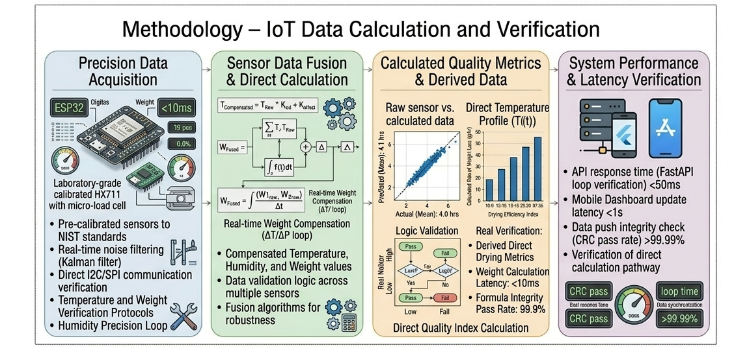
Methodology
IT22189394 | SANJAYA E W M | RP-026-079

Slide 38
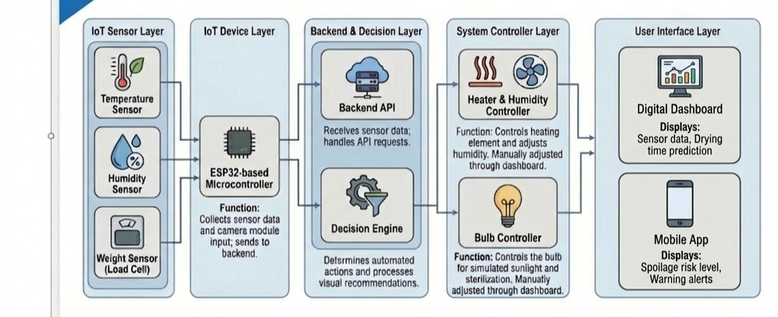
individual Component Diagram
IT22189394 | SANJAYA E W M | RP-026-079

Slide 39
Evidence of completion
Developed ESP32-based IoT monitoring prototype
Integrated temperature and humidity sensors
Implemented real-time data collection at fixed intervals
Defined safe / unsafe drying condition thresholds
​
IT22189394 | SANJAYA E W M | RP-026-079

Slide 40
References
[1] Food and Agriculture Organization of the United Nations (FAO), Postharvest Losses in the Multiday Fisheries Sector of Sri Lanka. Rome: FAO, 2023.
[2] L. Hin, M. Bunngak, M. H. Chhorn, Y. Meda, and S. Delele, “Development and Performance Assessment of Sensor-Mounted Solar Dryer for Micro-Climatic Modeling and Optimization of Dried Fish Quality in Cambodia,” AgriEngineering, vol. 6, no. 3, 2024.
[3] L. O. Freire, J. N. Castillo, E. F. Robalino, L. A. Flores, and D. F. Trujillo, “IoT System for Monitoring and Controlling Microclimates in a Fruit Fly Breeding Chamber,” Engineering Proceedings, vol. 115, no. 1, p. 2, 2025.
[4] X. T. Cao, T. B. Ngoc, S. M. Lee, J. H. Kim, and C. Park, “Range-extended wireless food spoilage monitoring with a high energy efficient battery-free sensor tag,” Sensors and Actuators A: Physical, vol. 301, 2020.
IT22189394 | SANJAYA E W M | RP-026-079

Slide 41
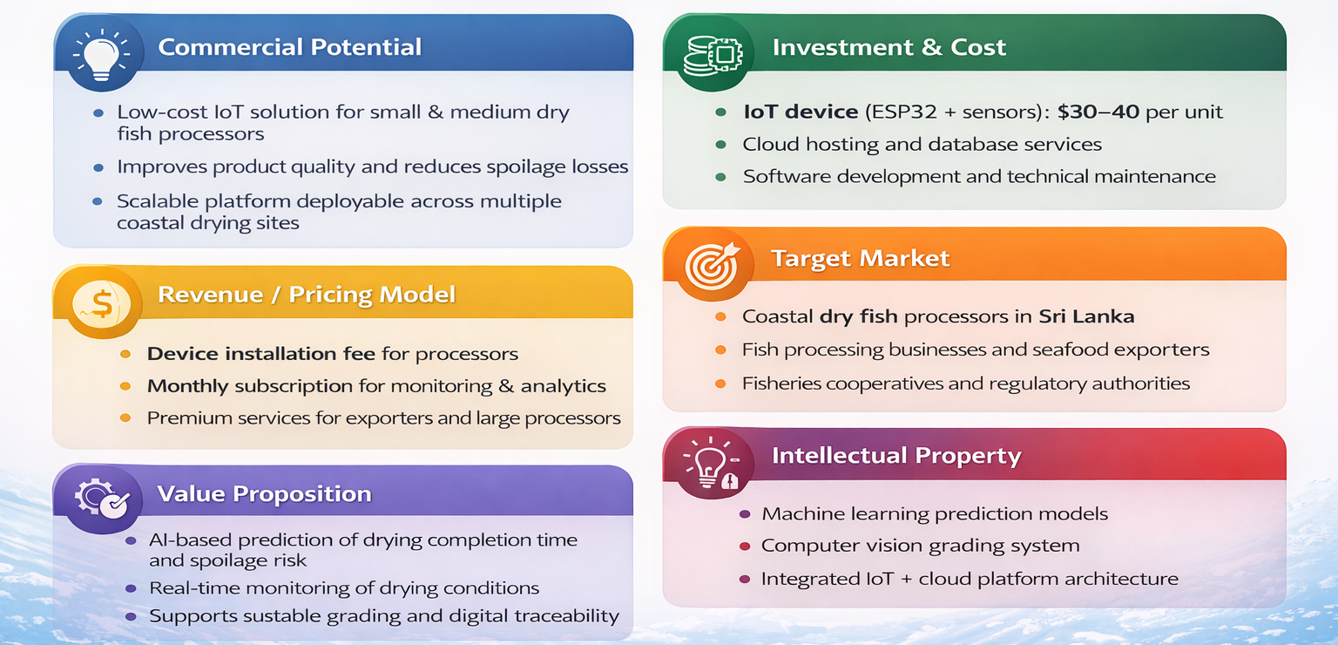
07. Commercialization Aspects

Slide 42
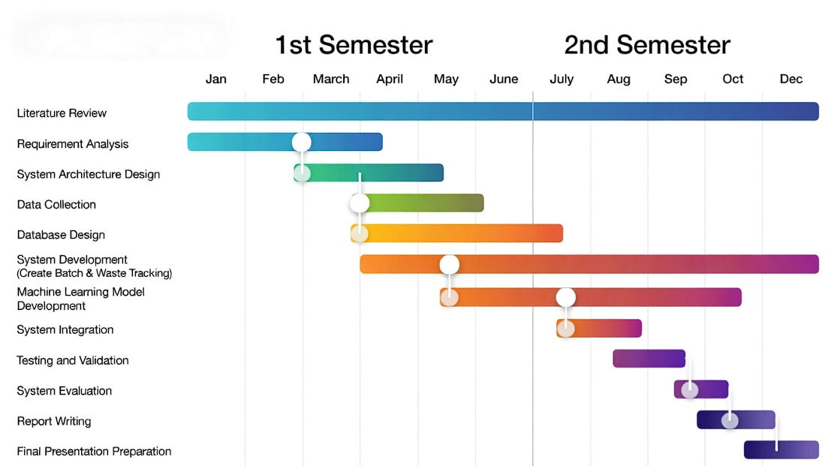
08. Gantt Chart

Slide 43
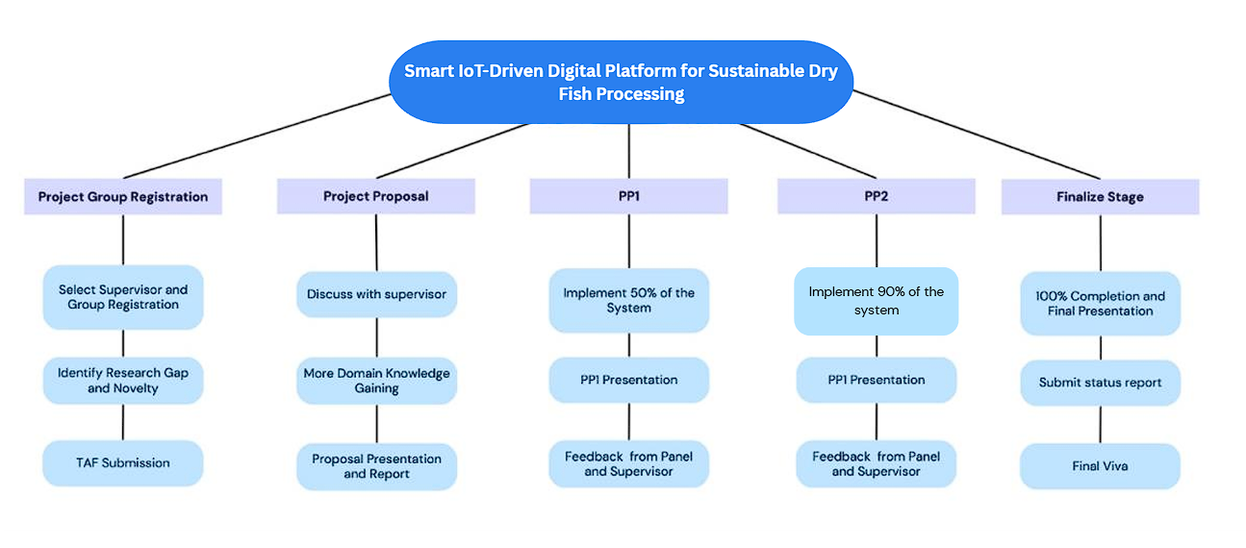
09. Work breakdown structure

Slide 44



Slide 45
Thank You!

