Slide 1




Project ID : RP-026-079

Slide 2


Our Team

Slide 3



Slide 4
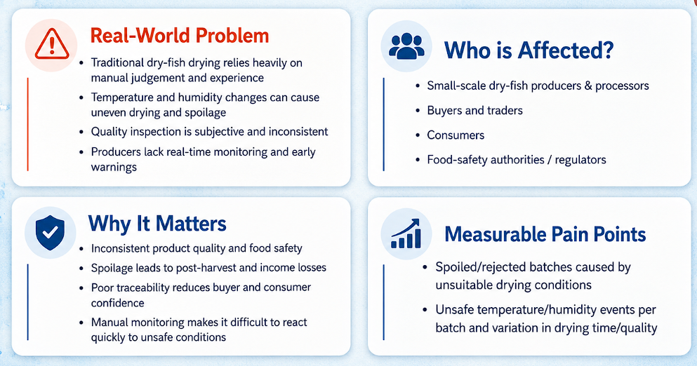
Problem & Stakeholders

Slide 5

Research Gap & Objectives

Slide 6
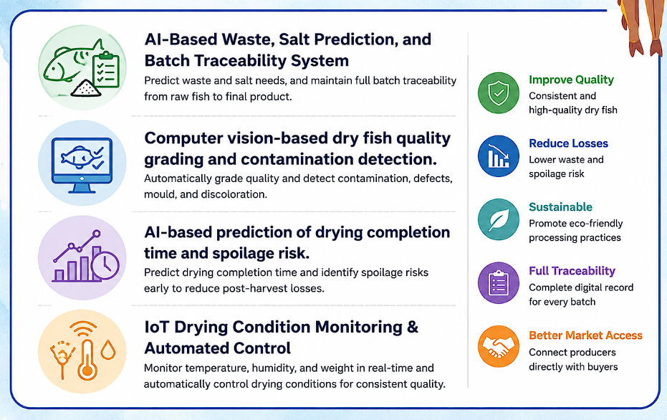
Our Solution

Slide 7
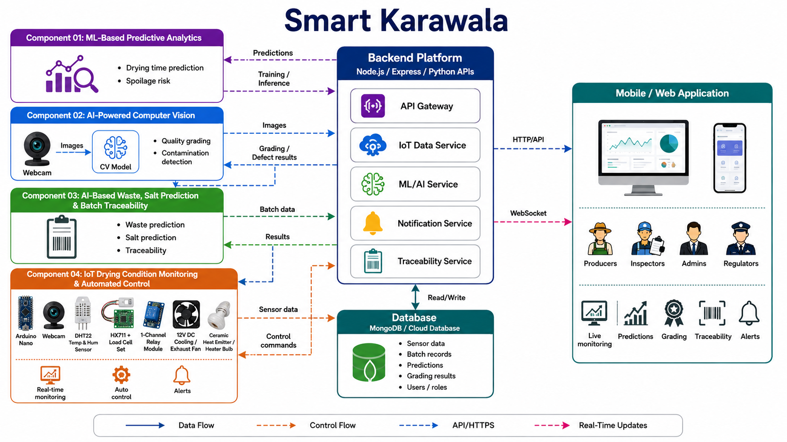

Slide 8
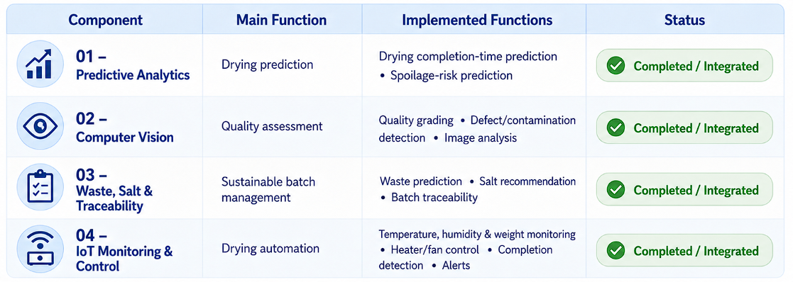
Integration & Implementation
Status

Slide 9
Evaluation Results
Module | Evaluation Metric | Result
Waste Prediction | MAE / RMSE / R² | 0.1219
Salt Prediction | MAE / RMSE / R² | 0.0176
Pre-Drying Prediction | R² | 0.745
Remaining-Time Prediction | R² / MAE / RMSE | 0.956 / 1.10 min / 1.50 min
Spoilage Risk | Rule/functional validation | Functionally tested

Slide 10
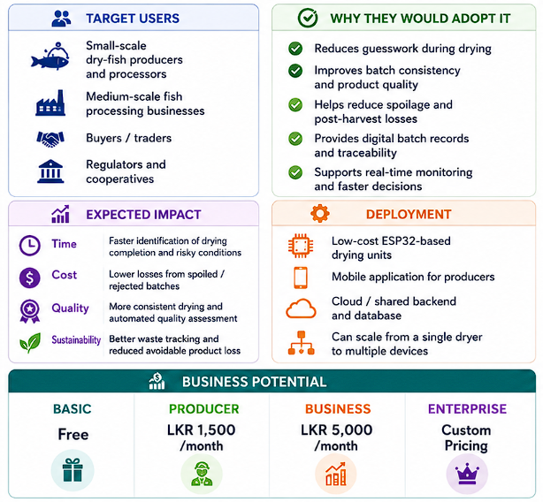
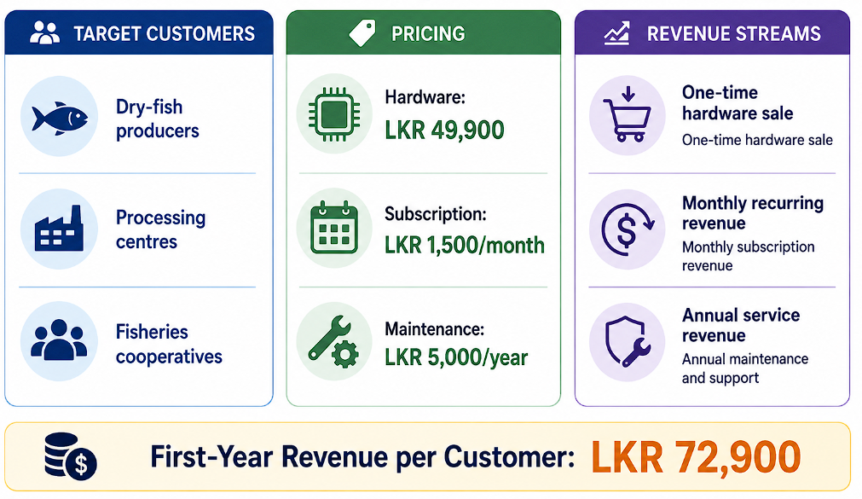
Commercialization

Slide 11
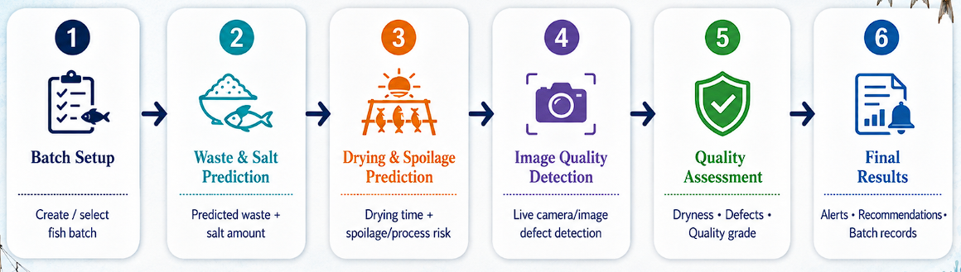
Live Demo Roadmap

Slide 12
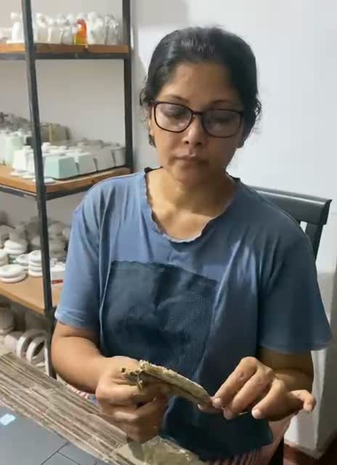
User
Feedback

Slide 13


