Slide 1
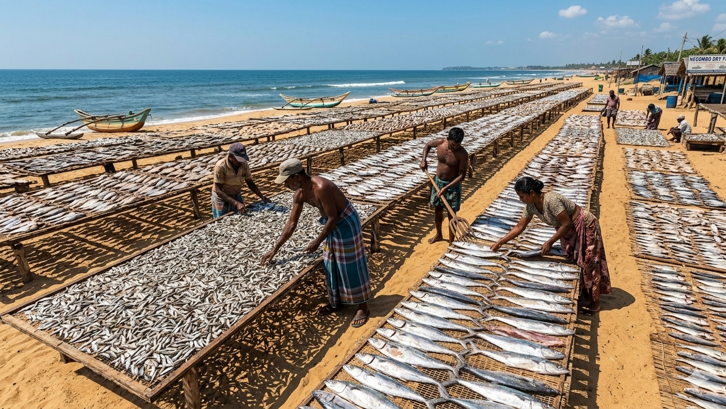

A Smart IoT-Driven Digital Platform for Sustainable Dry Fish Processing in Sri Lanka
Project ID : RP-026-079

Slide 2




Supervisor
Ms. Jenny Krishara
Co-Supervisor
Dr. Dinuka Wijendra
External Supervisor
Mr. Dinuth Jayasekara

Slide 3
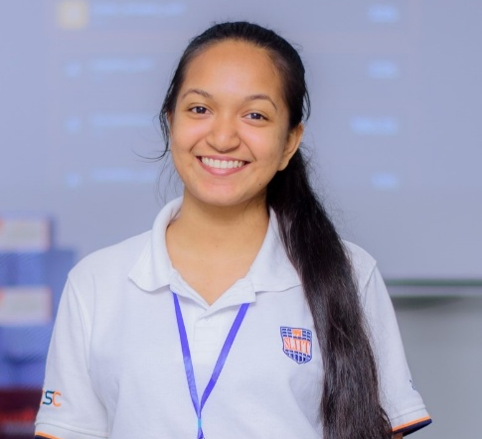


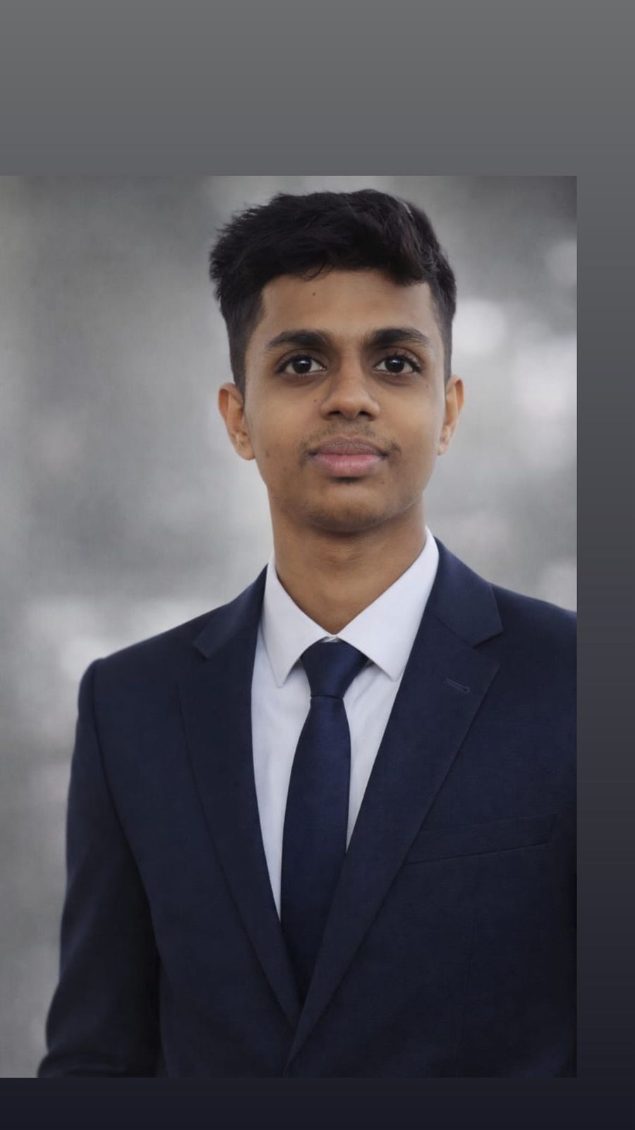
Team Leader
VIVIPEM L B R V IT22639844
GUNASEKARA D T C D P IT22127396
PESHALA G A K J IT22554536
SANJAYA E W M IT22189394

Slide 4
Content
Introduction Video
2. Introduction
3. Research Problem
4. Who will benefit from the solution
5. Comments
6. Individual component
7. Commercialization Plan
<< RP-026-079>>

Slide 5
01. Introduction Video
<< RP-026-079>>

Slide 6

<< RP-026-079>>

Slide 7
02. Introduction
About Dry Fish Processing?
Importance of the Industry
Supports many coastal fishing communities.
Provides an affordable protein source.
Reduces fish spoilage and waste.
Traditional fish preservation method in Sri Lanka.
Fish is cleaned, salted, and sun-dried to extend shelf life.
What will the System Improve?
Monitor drying conditions using IoT sensors.
Predict drying time and spoilage risk.
Maintain digital records of processing batches.
<< RP-026-079>>

Slide 8
03. Research Problem
Current Challenges
Drying decisions depend on experience.
Weather conditions affect drying quality.
Lack of monitoring and traceability systems.
Impact
Post-harvest losses and inconsistent product quality.
Limited traceability of processing batches.
<< RP-026-079>>

Slide 9
05. Comments
VIVIPEM L B R V IT22639844 | No functional/ non-functional requirements are listed. Need to consider the "smell" of the dry fish. Without using existing algorithms, try to optimize. Add some more features to the component. | Integrated MQ-136 smell sensor feature for spoilage-risk analysis. Compared multiple machine learning models instead of using a single existing approach. Added additional prediction features such as weight-loss percentage and weight-loss rate. Included smart recommendation generation to improve drying efficiency and reduce spoilage risk.
<< RP-026-079>>

Slide 10
GUNASEKARA D T C D P IT22127396 | No functional/ non-functional requirements are listed. Suggested to enhance the component. Add some more features to the component. | Establish a self-learning retraining pipeline to improve model accuracy over time. Integrate AI-assisted annotation and automatic dataset generation for faster retraining workflows
<< RP-026-079>>

Slide 11
PESHALA G AK J IT22554536 | No functional/ non-functional requirements are listed. Add some more features to the component. | The salting monitoring system uses an ESP32 and load cell to track fish weight and salting time in real time. It calculates weight loss and automatically identifies the salting completion stage. Detects overloaded drying trays using weight and tray size data. Helps prevent slow drying, spoilage, and quality reduction. Handles product browsing, search, customer profiles, order history, and order tracking to improve customer interaction and user experience.
<< RP-026-079>>

Slide 12
SANJAYA E W M IT22189394 | No functional/ non-functional requirements are listed. Add some more features to the component. | Handles cart management, checkout, payments, sales tracking, and blockchain-based transaction verification for secure and transparent order management.
<< RP-026-079>>

Slide 13

VIVIPEM L B R V | IT22639844
BSc (Hons) Degree in Information Technology (Specialization in Information Technology)
IT22639844 | VIVIPEM L B R V | RP-026-079

Slide 14

How the Solution Addresses the Sub-Problem
• Predicts drying completion time using machine learning models.
• Predicts spoilage risk levels during the drying process.
• Analyzes sensor-based drying data for decision making.
• Generates smart recommendations to improve drying efficiency.
• Helps reduce spoilage and drying-related losses.
User Requirements Addressed
• Accurate drying-time estimation.
• Early spoilage-risk prediction.
• Easy-to-understand risk indicators and alerts.
• Better drying management and monitoring support.
• Real-time access to prediction results.
Notes:
“Good morning everyone.
My component is an ML-based predictive analytics module for dry fish processing.
This module predicts drying completion time and spoilage risk using machine learning models.
The system analyzes temperature, humidity, elapsed drying time, weight-loss rate, and smell sensor values.
The main objective is to reduce spoilage and drying-related losses by providing early predictions and smart recommendations.
This solution helps users with accurate drying-time estimation, spoilage-risk alerts, and real-time monitoring support.”

Slide 15
Design Excellence / Contribution
• Developed machine learning models for drying-time prediction and spoilage-risk classification.
• Integrated environmental parameters such as temperature, humidity, weight-loss rate, and smell sensor values.
• Created FastAPI-based prediction APIs for model integration.
• Compared multiple ML models and selected best-performing models using evaluation metrics.
• Designed scalable architecture for future real-time IoT data integration.
User Feedback on Prototype
• Users liked the idea of automatic drying-time estimation and smart recommendations.
• Users requested mobile-friendly monitoring and alert notifications.
• Users found the spoilage-risk alerts useful for early decision making.
• Users suggested integrating live weather data for more accurate drying predictions.
Notes:
For this component, I developed machine learning models for drying-time prediction and spoilage-risk classification.
I integrated environmental parameters such as temperature, humidity, weight-loss rate, and MQ-136 smell sensor values.
I also created FastAPI-based backend APIs for model integration and compared multiple ML models using R2 Score, MAE, and RMSE evaluation metrics.
According to user feedback, users liked the automatic drying-time estimation and spoilage-risk alerts.
They also suggested adding mobile-friendly monitoring and live weather integration in the future.

Slide 16
Enhancement | Future Enhancement
Created simulated datasets for drying-time and spoilage-risk prediction | Collect real IoT sensor data from drying chambers
Trained initial ML models for prediction tasks | Improve model accuracy using larger datasets
Developed FastAPI backend for prediction services | Integrate live sensor streaming and real-time alerts
Added MQ-136 smell sensor feature for spoilage analysis | Explore advanced models such as XGBoost and LSTM
Tested API endpoints using dummy sensor values | Integrate frontend dashboard and mobile notifications
Notes:
Currently, I created simulated datasets and trained initial ML models for prediction tasks.
I also developed FastAPI backend services and tested APIs using dummy sensor values.
Additionally, I added the MQ-136 smell sensor feature for spoilage analysis.
As future enhancements, I plan to collect real IoT sensor data from drying chambers to improve model accuracy.
I also plan to integrate real-time sensor streaming, frontend dashboards, mobile notifications, and advanced models such as XGBoost and LSTM. Long Short-Term Memory.

Slide 17
GUNASEKARA D T C D P | IT22127396
BSc (Hons) Degree in Information Technology (specialization in Information Technology)
IT22127396 | GUNASEKARA D T C D P | RP-026-079

Slide 18

How the Solution Addresses the Sub-Problem
Developed an AI-based system for dry fish quality grading and contamination detection.
Implemented a YOLOv8 segmentation verification station for defect identification.
Enabled professional review for low-confidence AI predictions.
Used standardised image capture to improve prediction consistency.
Integrated grading results with IoT data and traceability records.
User Requirements Addressed
Automated grading for Grade A, B, and C dry fish.
Detection of mould, uneven drying, damage, and contamination.
Verification dashboard for reviewing predictions.
Batch history and image evidence storage.
Fast prediction and scalable AI model management.
Notes:
Here I explain how my AI solution addresses the dry fish quality grading problem.
I developed a YOLOv8 segmentation-based system to detect contamination and defect regions.
The Verification Station helps professionals review low-confidence predictions and improve dataset quality.
Currently, I have successfully trained a segmentation model using Google Colab and YOLOv8 workflows.

Slide 19
Design Excellence / Contribution
Created a Sri Lankan dry fish image dataset for AI training.
Designed a polygon-based segmentation annotation system.
Developed a complete workflow for dataset creation, YOLO training, and verification.
Built scalable architecture using Next.js, FastAPI, MongoDB, and YOLOv8.
Added continuous learning support through retraining workflows
User Feedback on Prototype
Users requested clearer defect highlighting on images.
Suggested adding more defect categories such as raw and less-dried fish.
Positive feedback received for the verification dashboard usability.
Users preferred faster AI model upload and activation features.
Recommended future live camera monitoring and automated retraining support.
Notes:
This slide explains the main contribution and user feedback of my component.
I created a polygon-based annotation and verification system for segmentation training.
The architecture uses Next.js, FastAPI, MongoDB, and YOLOv8.
Users provided positive feedback about the verification dashboard and suggested adding more defect categories and live camera monitoring.

Slide 20
Enhancement | Future Enhancement
Collect and label a Sri Lankan dry fish image dataset covering Grade A, B, C and defects. | Implement dual-mode camera for live streaming and periodic auto-capture under standardised lighting
Train a CNN model using transfer learning achieving minimum F1-score of 0.75. | Establish a self-learning retraining pipeline to improve model accuracy over time.
Develop a Verification Station for professionals to review and correct low-confidence predictions. | Integrate AI-assisted annotation and automatic dataset generation for faster retraining workflows
Integrate grading results with predictive analytics and batch traceability record. | Develop real-time defect segmentation and spoilage risk prediction using live camera analysis
Implement polygon-based defect segmentation for exact damaged region identification. switching | Deploy scalable cloud-based AI model management with automatic model version switching
Notes:
This slide shows the current enhancements and future enhancements of the system.
Currently, the prototype supports dataset collection, YOLO segmentation training, verification workflows, and traceability integration.
In the future, we plan to collect more real-world Sri Lankan dry fish data using this prototype and retrain the model with all required defect categories such as mould, uneven drying, contamination, and damaged regions.
We also plan to implement live camera monitoring, automated retraining, and cloud-based AI model management.

Slide 21
PESHALA G A K J | IT22554536
BSc (Hons) Degree in Information Technology (specialization in Information Technology)
IT22554536 | PESHALA G A K J | RP-026-079

Slide 22

Component 03: AI-Based Waste, Salt Prediction, and Batch Traceability System for Sustainable Dry Fish Processing
How the Solution Addresses the Sub-Problem
Predicts fish waste amount using machine learning.
Recommends required salt quantity based on cleaned fish weight.
Helps processors improve resource management and reduce waste.
Stores batch records for traceability and monitoring.
User Requirements Addressed
Easy batch creation and management.
Fast waste prediction for different fish types.
Accurate salt recommendations for drying preparation.
Simple dashboard interface for users.
Real-time access to processing records and notifications.

Slide 23
Design Excellence / Contribution
Developed a microservice-based backend architecture.
Integrated machine learning models with Node.js backend.
Created REST APIs for waste prediction and batch management.
Designed user-friendly mobile UI prototypes.
Implemented MongoDB database integration for data storage.
User Feedback on Prototype
Users preferred a simple and easy-to-understand interface.
Complex dashboards were redesigned into cleaner layouts.
Larger buttons and clear icons improved usability.
Users requested quick access to alerts and batch details.
Feedback highlighted the need for mobile-friendly navigation.

Slide 24
Enhancement | Future Enhancement
Batch create (CRUD) functions implemented | Real-time salt absorbing monitor with IoT sensor integration
Trained initial ML models for waste prediction tasks | Live monitoring and alert notifications
Trained initial ML models for salt prediction tasks | Business process automation
Developed waste company notification system | Batch traceability and record management system implemented
Developed REST APIs for backend communication | Cloud deployment and scalability

Slide 25
SANJAYA E W M | IT22189394
BSc (Hons) Degree in Information Technology (specialization in Information Technology)
IT22189394 | SANJAYA E W M | RP-026-079

Slide 26

How the Solution Addresses the Sub-Problem
Continuously monitors temperature and humidity during the drying process.
Detects unsafe drying conditions using IoT sensors and threshold rules.
Provides early warnings for high humidity and unstable conditions.
Displays live environmental data and trends through a real-time dashboard.
Helps improve dry fish quality and reduce spoilage risks during processing.
User Requirements Addressed
Real-time monitoring of drying environment conditions.
Early alert notifications for risky drying situations.
Easy-to-use dashboard for viewing live sensor readings.
Continuous batch monitoring with automated updates.
Improved decision-making for drying and storage management
Notes:
Good morning everyone.
Our research project is called “A Smart IoT-Driven Digital Platform for Sustainable Dry Fish Processing in Sri Lanka.” �
Proposal_R26-IT-079-Milan.docx
My component focuses on IoT-based drying condition monitoring and automatic control for the dry fish drying process. �
TAF_R26-IT-079 (2) (2).pdf
Currently, in Sri Lanka, dry fish drying is mostly done manually using experience and visual judgement. Because of sudden rain, high humidity, and unstable temperature conditions, many batches become spoiled or contaminated. This causes post-harvest losses and inconsistent product quality. �

Slide 27
Design Excellence / Contribution
Developed a low-cost IoT-based drying monitoring prototype using raspberry.
Integrated temperature, humidity, and weight sensors for real-time monitoring.
Implemented automatic heater and humidity control using relay modules.
Created REST API communication between IoT module and AI vision module.
Designed a live dashboard with alerts, sensor trends, and drying progress monitorin.
User Feedback on Prototype
Users preferred a simple dashboard with clear live sensor readings.
Real-time humidity and temperature alerts improved user confidence.
Users requested larger status indicators for drying conditions and alerts.
Weight-based drying completion notifications were considered useful and practical.
Feedback highlighted the importance of mobile-friendly monitoring access.

Slide 28
Enhancement | Future Enhancement
Developed IoT-based drying environment monitoring prototype | AI-based spoilage prediction using sensor data
Implemented real-time temperature and humidity monitoring | Advanced automated drying control with smart optimization
Integrated load cell for weight-based drying completion detection | Cloud-based multi-device monitoring and analytics
Developed threshold-based alert and notification system | Predictive maintenance for IoT sensors and devices
Created REST API integration between IoT and AI vision module | Fully automated smart drying chamber with adaptive control

Slide 29
07. Commercialization Plan
Customer Persona Dry fish manufacturers and processing companies Small and medium-scale fish drying businesses Seafood exporters and quality control managers Factory owners who need automated monitoring and waste reduction
Customer Persona
Dry fish manufacturers and processing companies
Small and medium-scale fish drying businesses
Seafood exporters and quality control managers
Factory owners who need automated monitoring and waste reduction
Customer Persona Dry fish manufacturers and processing companies Small and medium-scale fish drying businesses Seafood exporters and quality control managers Factory owners who need automated monitoring and waste reduction
Market Size
Large demand from Sri Lankan dry fish industry
Can be expanded to seafood processing industries in South Asia
Increasing need for smart food quality and traceability systems
Growing market for AI + IoT based industrial automation solutions

Slide 30
07. Commercialization Plan
Customer Persona Dry fish manufacturers and processing companies Small and medium-scale fish drying businesses Seafood exporters and quality control managers Factory owners who need automated monitoring and waste reduction
What is Unique in Our Solution
AI-powered fish quality grading and contamination detection
IoT-based real-time drying condition monitoring
Automated spoilage risk prediction and alerts
Self-learning verification system to improve model accuracy over time
Combination of AI, IoT, and automation in one integrated platform
Customer Persona Dry fish manufacturers and processing companies Small and medium-scale fish drying businesses Seafood exporters and quality control managers Factory owners who need automated monitoring and waste reduction
How Will the Cost Be Recovered?
Selling the smart drying system to dry fish manufacturers
Monthly subscription for AI monitoring dashboard and analytics
Maintenance and technical support services
Future expansion with premium features and data analytics services

Slide 31
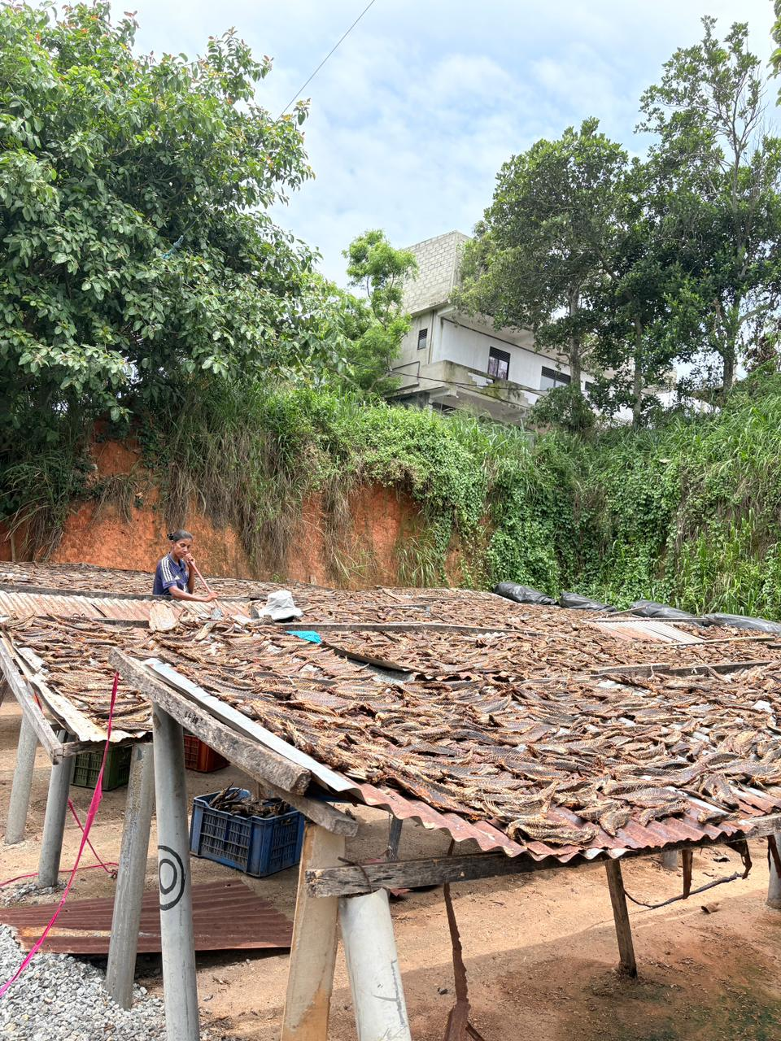
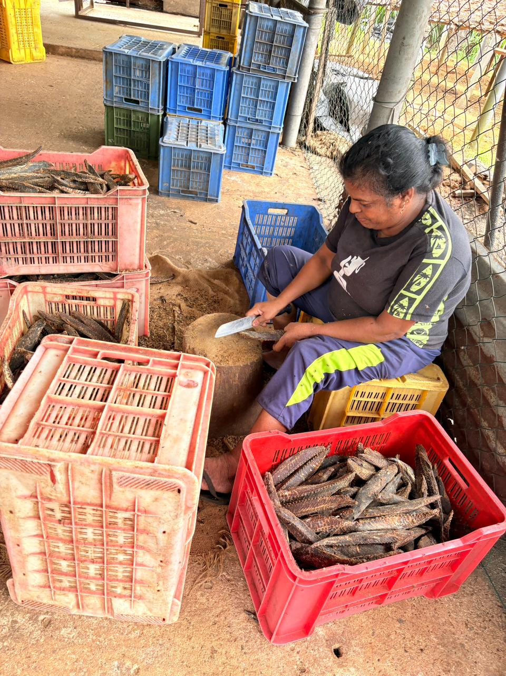
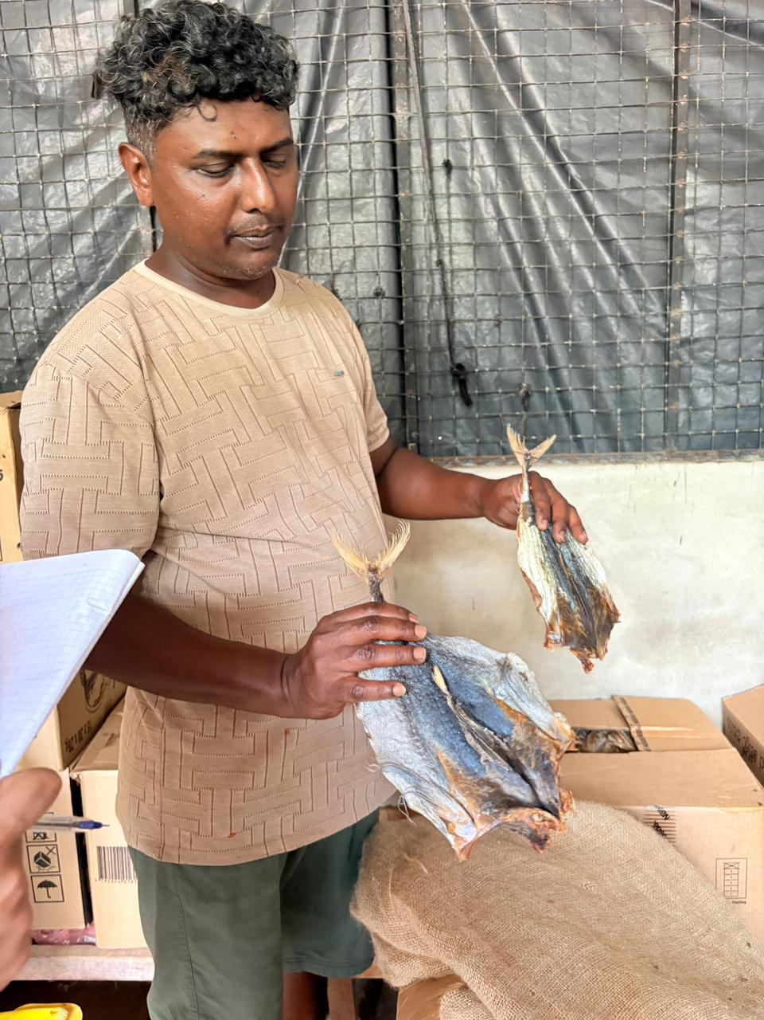
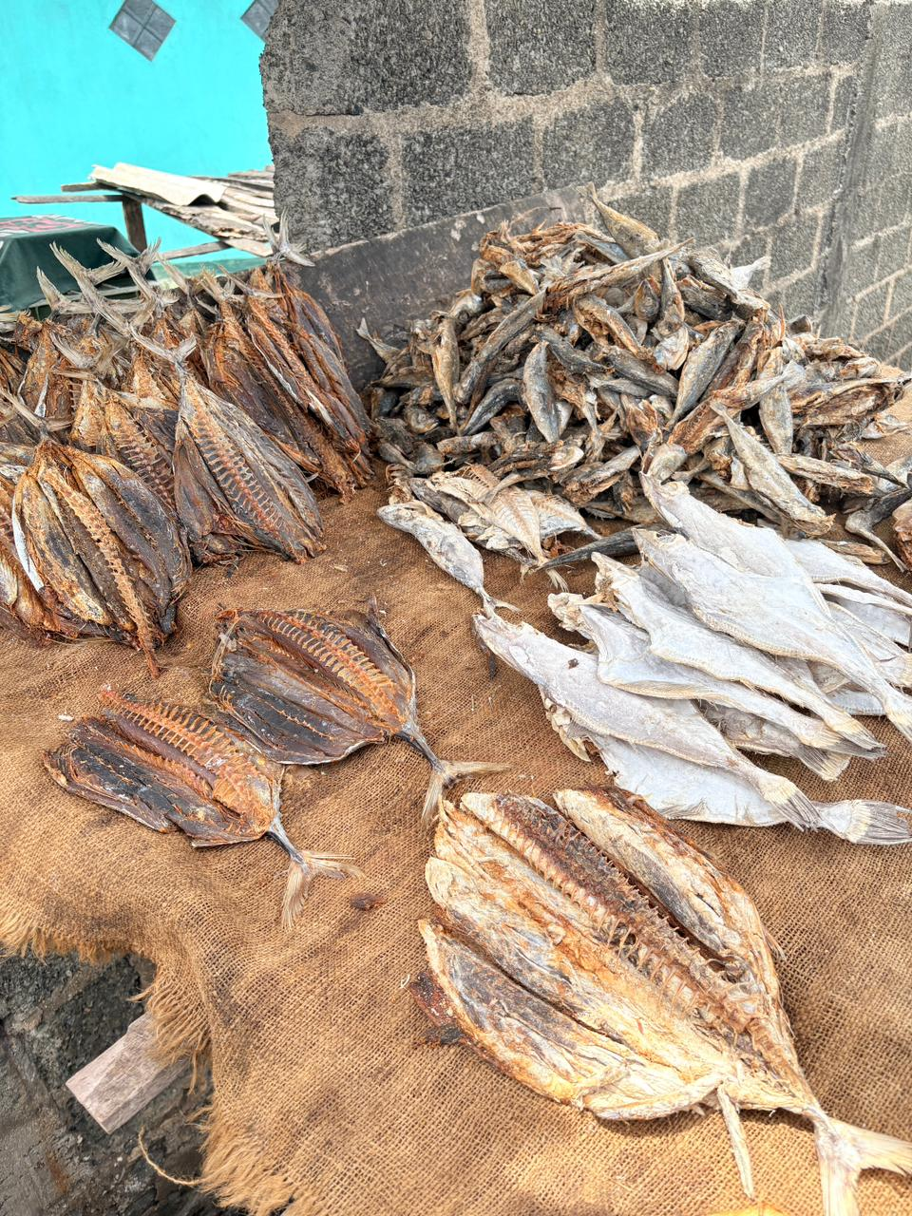
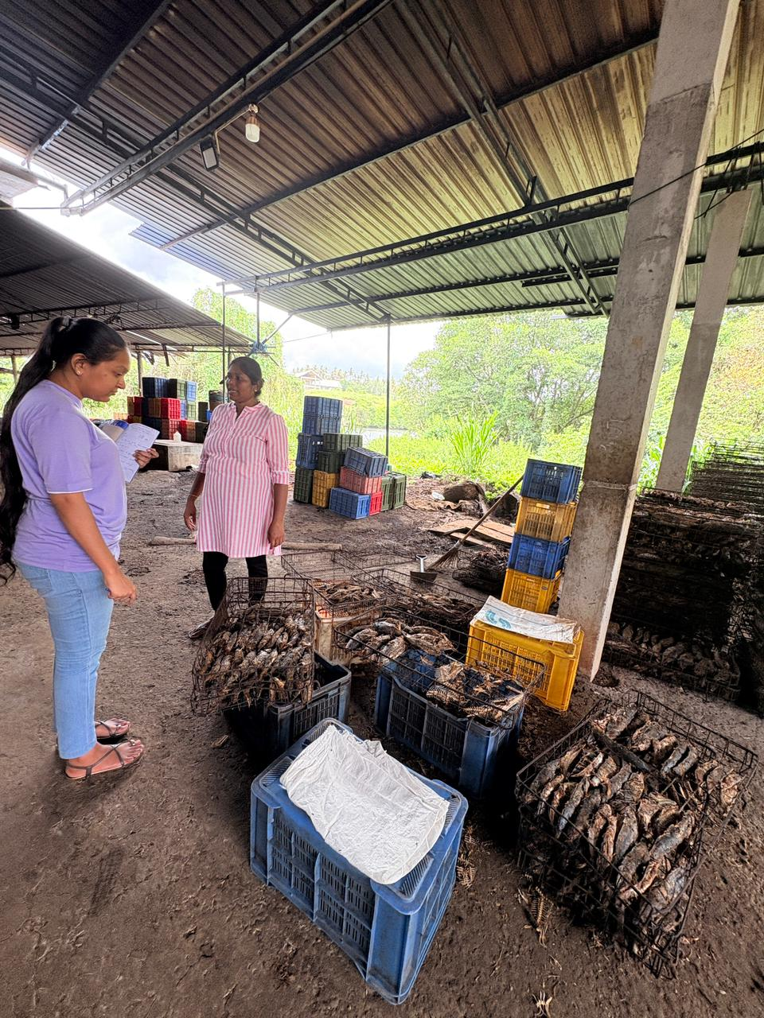
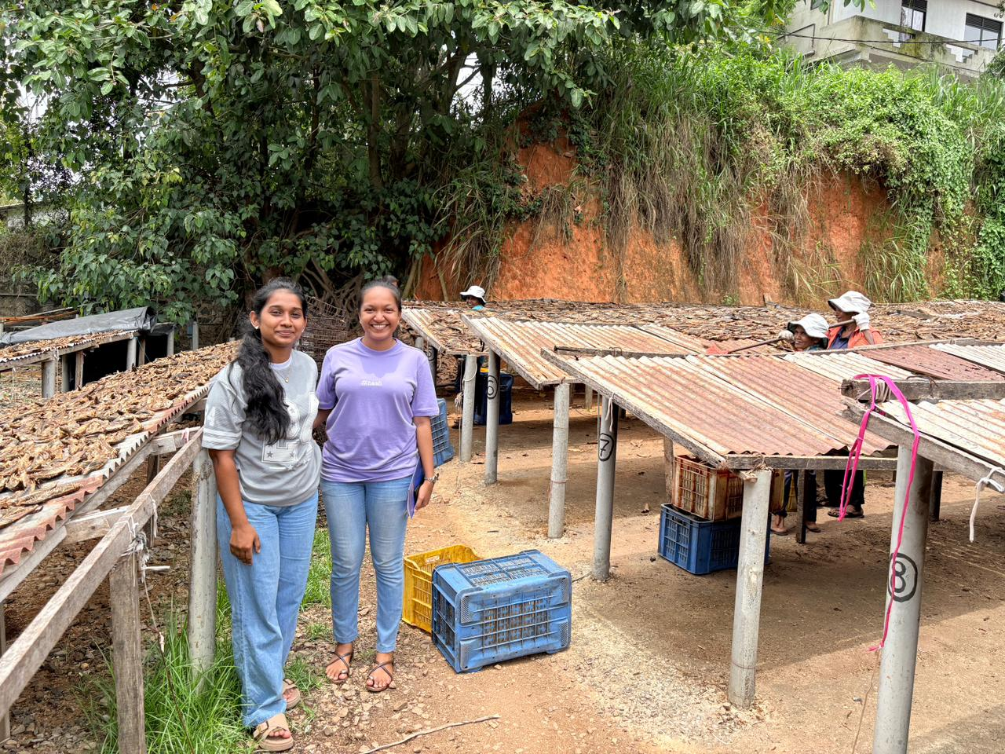
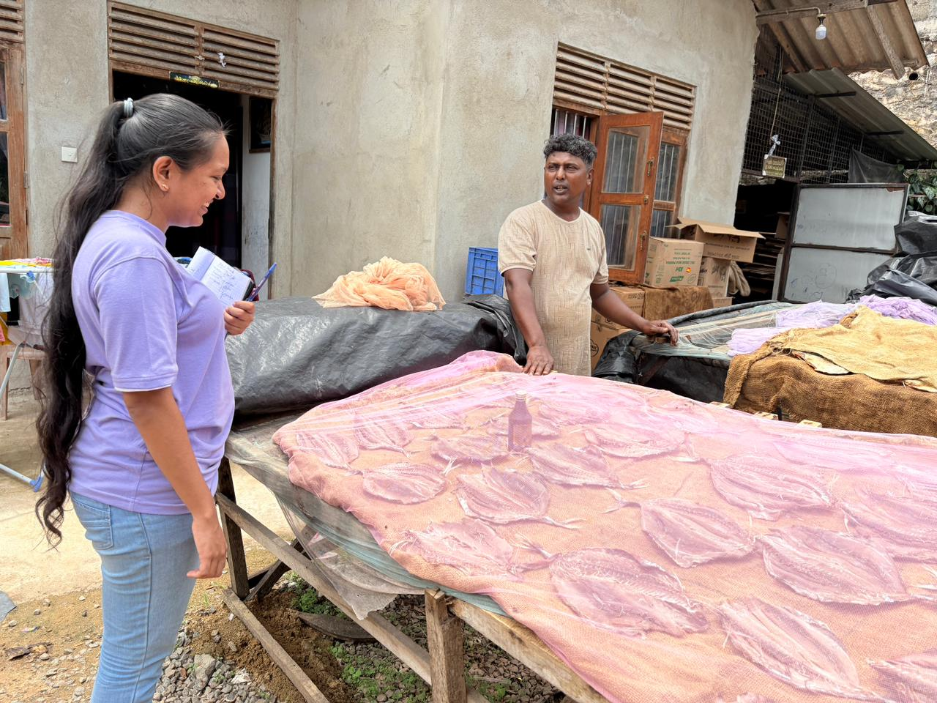
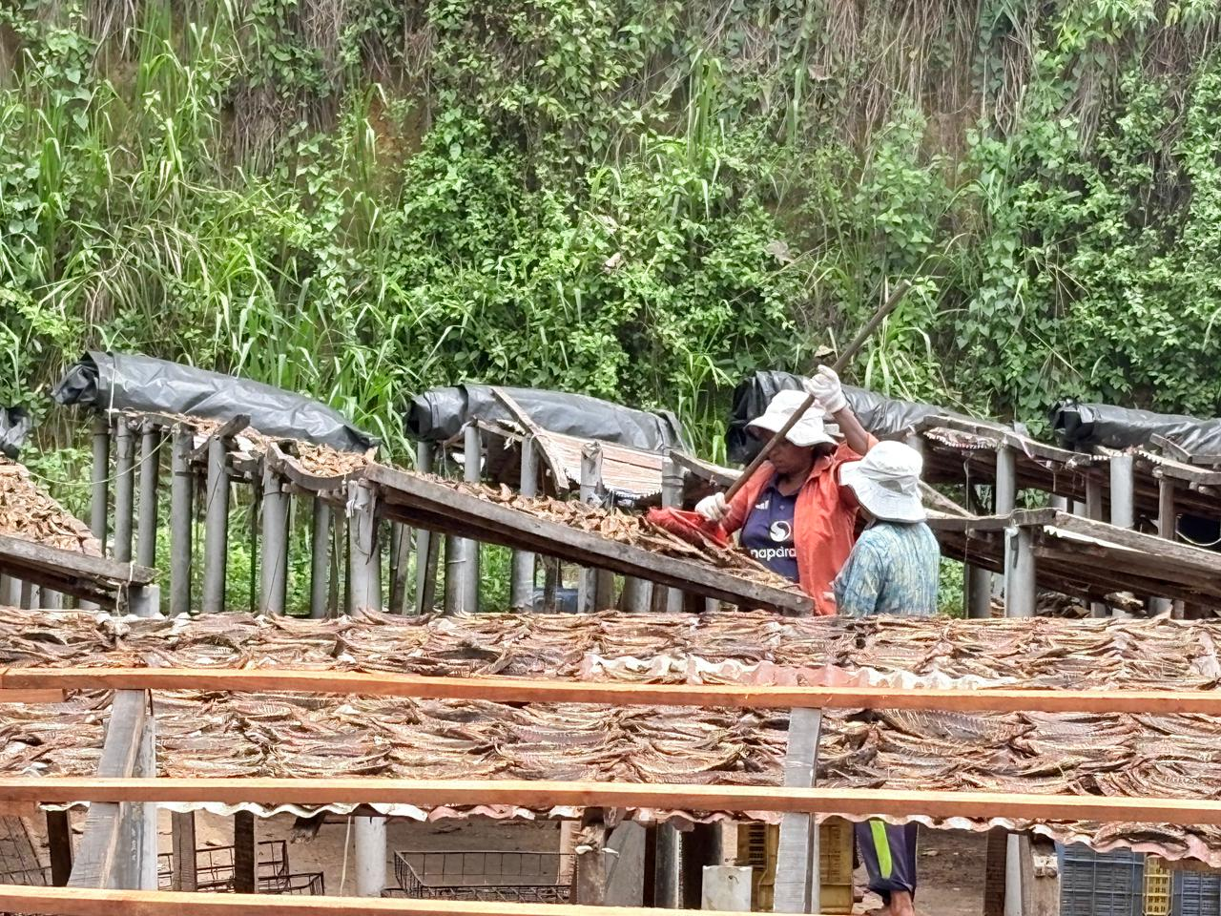
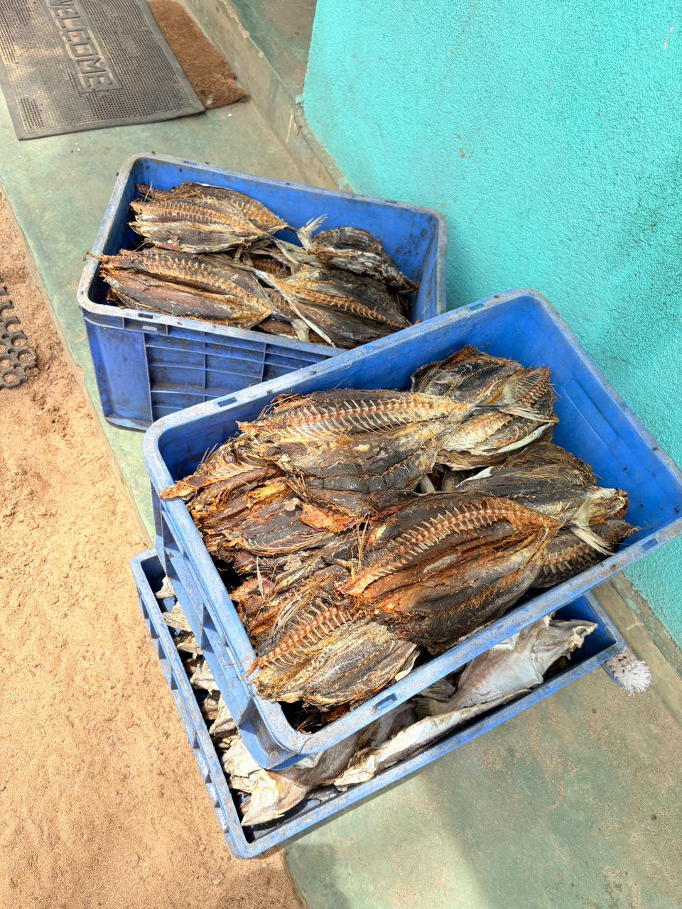
08.Data Collecting Process
<< RP-026-079>>

Slide 32
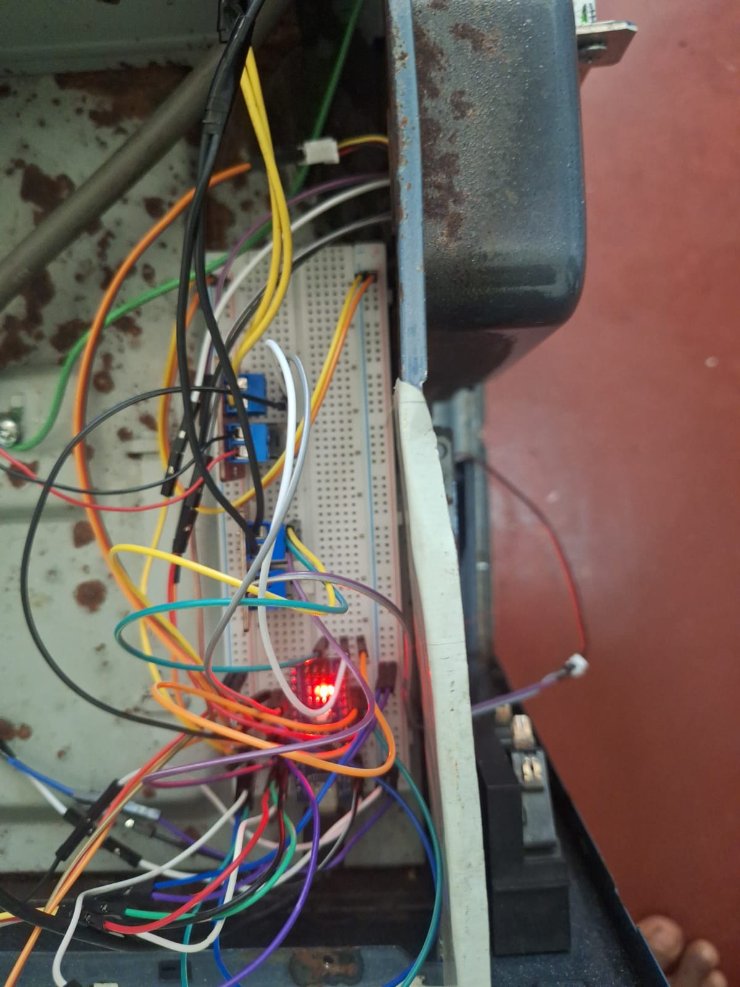
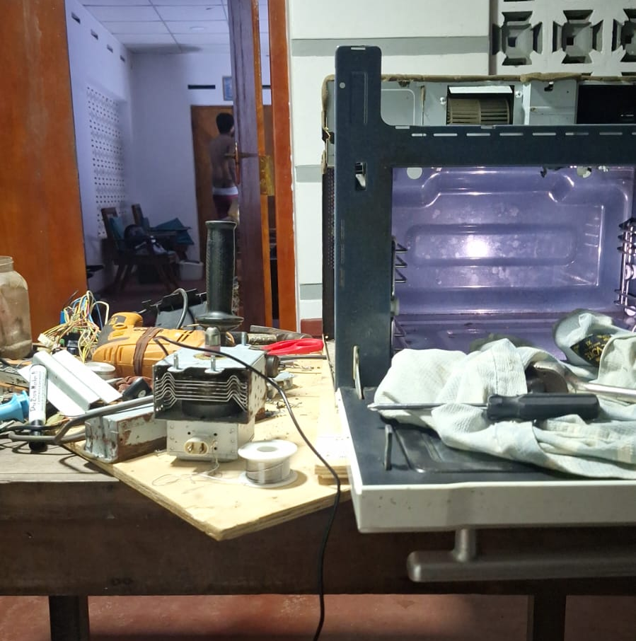
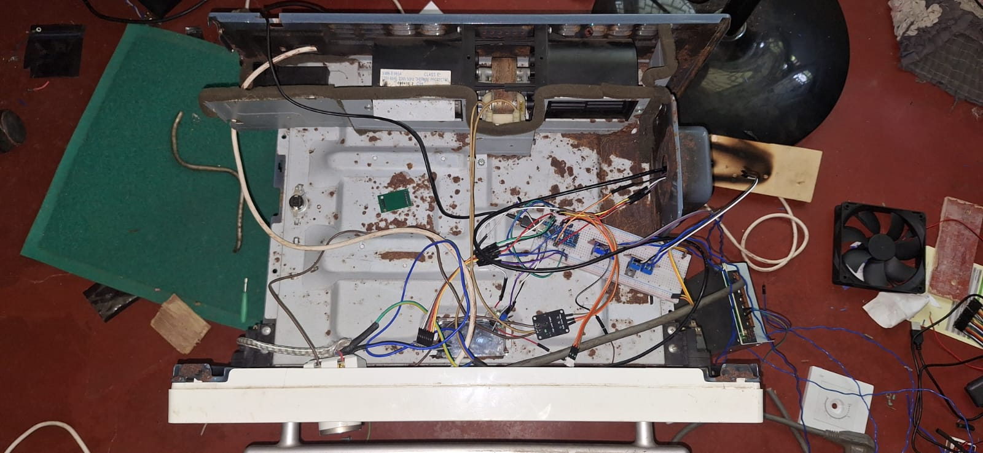
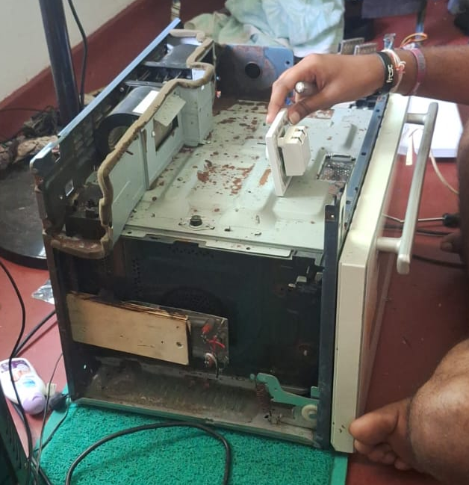
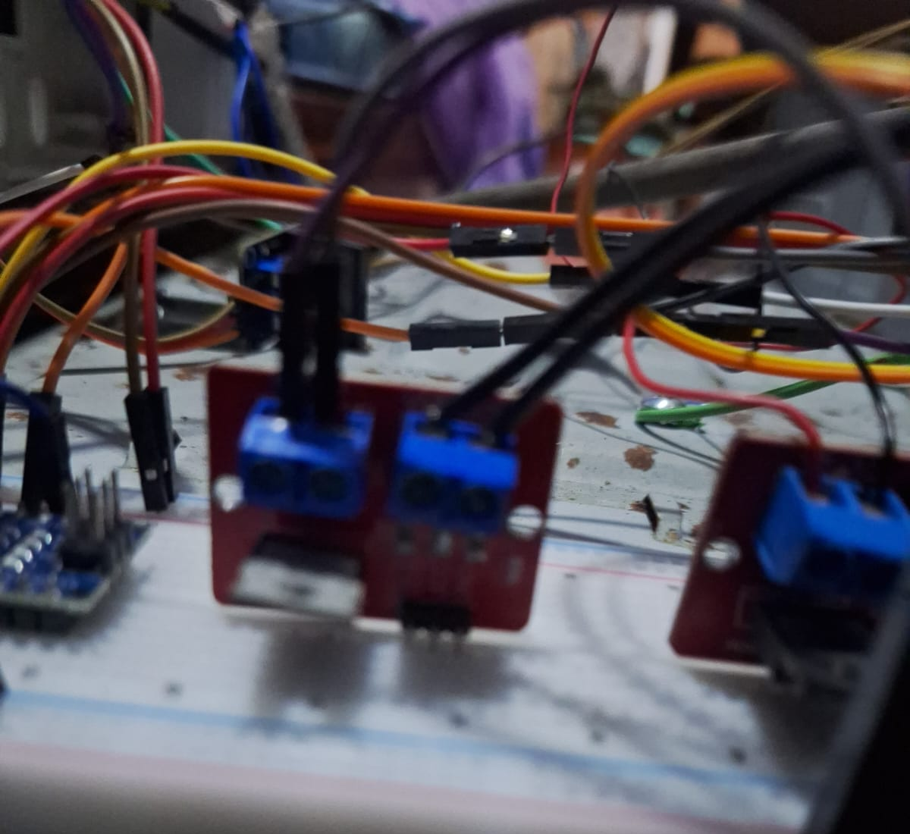
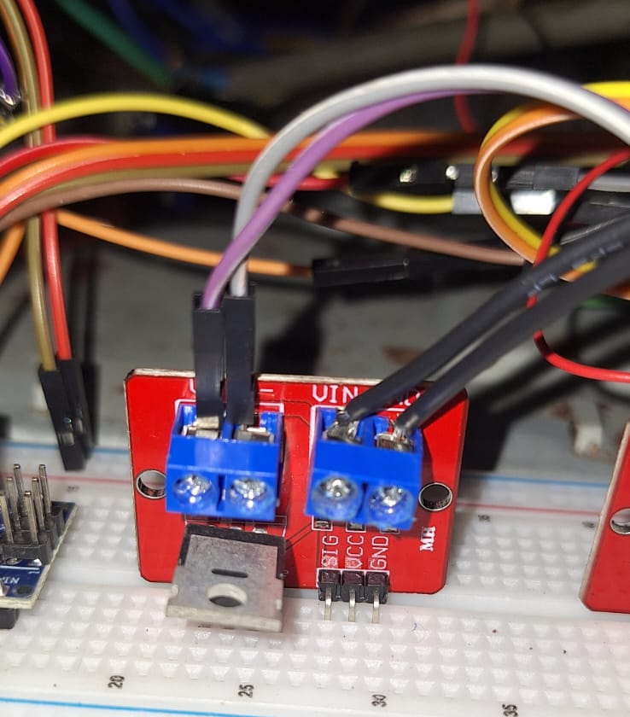
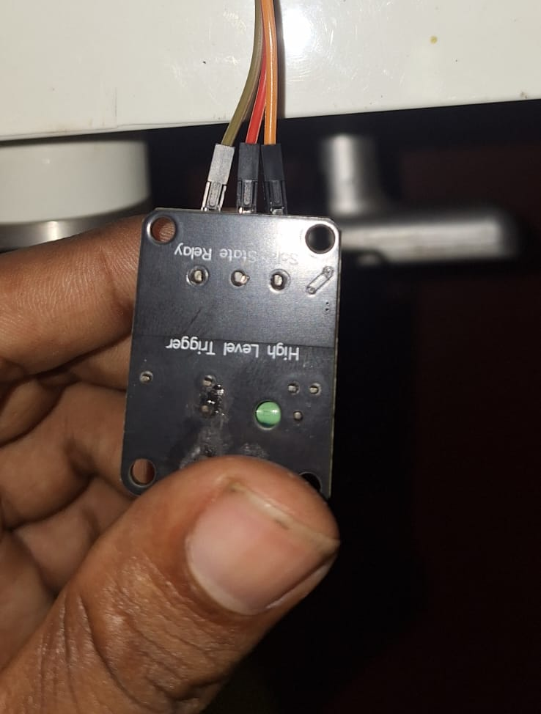
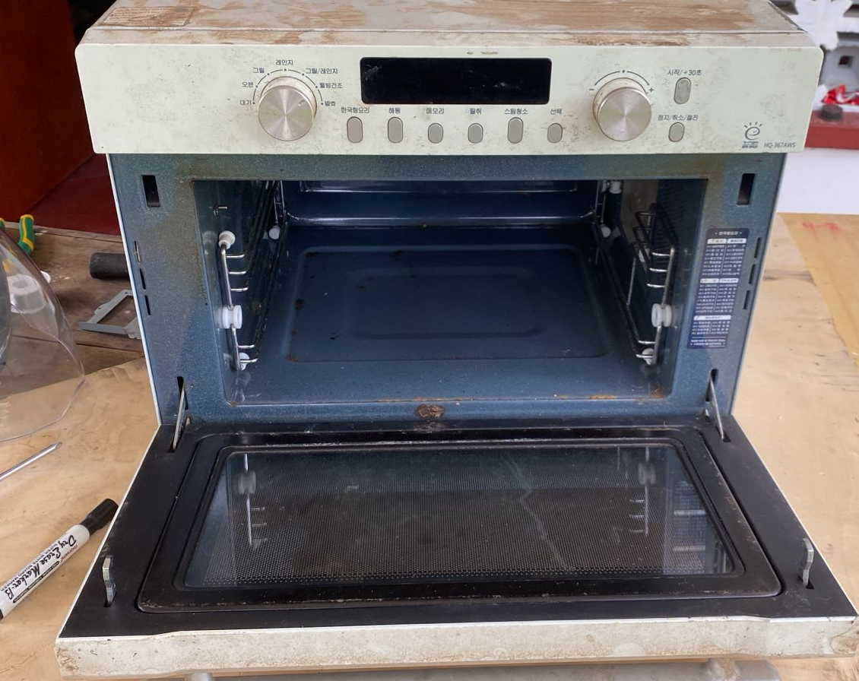
09. IOT Device Installation Process
<< RP-026-079>>

Slide 33



Slide 34
Thank You!

